Slide 1
Managing Post-Soviet Conflict
Recent Events in Ukraine/Crimea, New Roles for the BRICS, and the Ethics of COEX Interventions

Slide 2
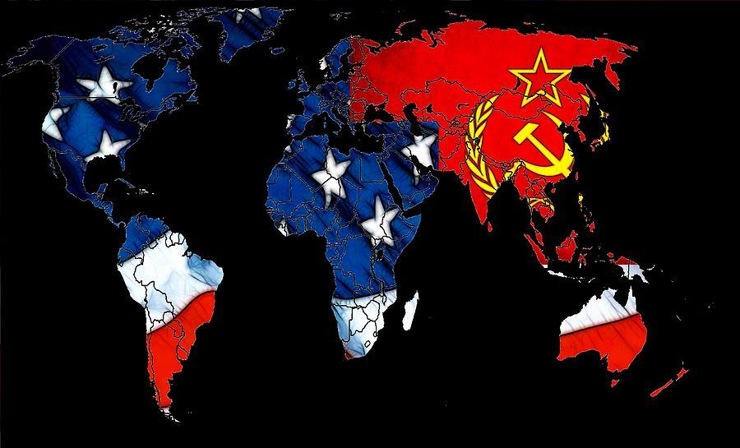

Slide 3
OVERVIEW
- Symptom of a far larger Geo-political Process
- Brief history of Cold War
- Post-Soviet Conflict 1992-2014
- Peacebuilding Ethics
- Negotiations Prep Simulation
- Role of BRICS in fostering Multipolarism
- Conflict Management Recommendations
- Track 1
- Track 2
- Track 3

Slide 4
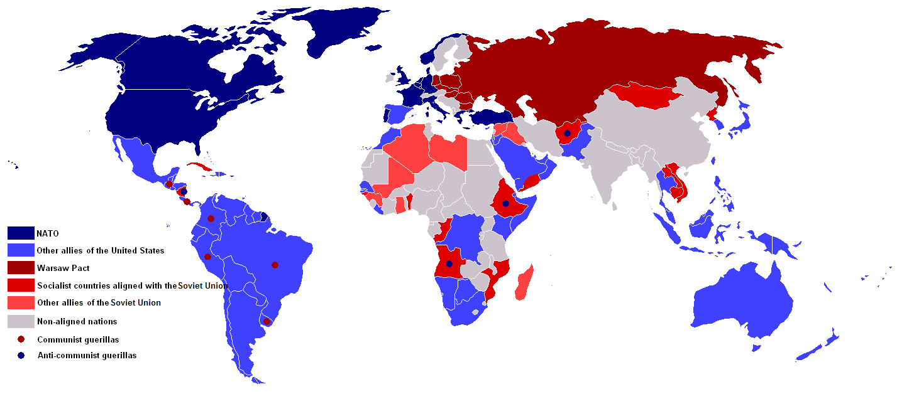
The Cold War 1945-1989

Slide 5
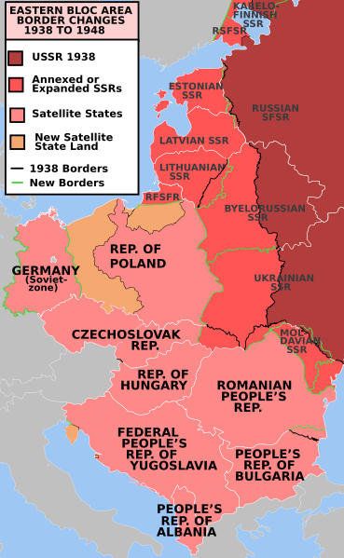
The Cold War
1945-1991
1945-48: Relationship between the Allies/US and USSR sours
1949: NATO established
1955: Warsaw Pact signed
Pattern of “proxy-wars” and political
maneuvering to gain alliances and influence
In Ukraine:
gained independence in 1921
incorporated into the USSR as the Ukraine SSR
partially independent, partially under USSR control
territorial flux -- 1939 part of Poland, 1940s parts of
Czechoslovakia and Romania, 1952 Russian Crimea
independence 1991 -- collapse of Soviet system

Slide 6
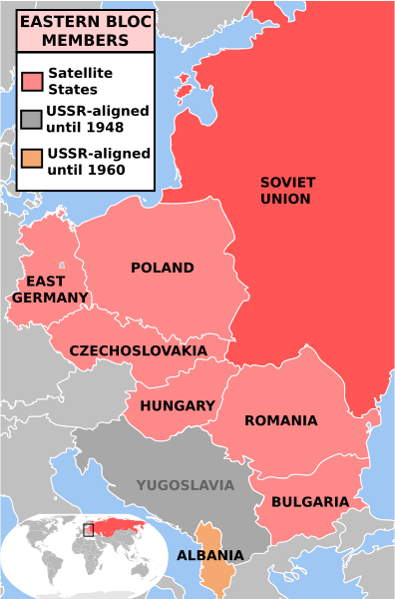
Former Warsaw Pact States:
Bulgaria
Czechoslovakia
East Germany
Hungary
Poland
Romania
Albania
Former Yugoslavia:
Kosovo
Croatia
Macedonia
Montenegro
Serbia
Slovenia
Bosnia and Herzegovina
Notes:
http://www.aljazeera.com/news/europe/2014/03/timeline-ukraine-political-crisis-201431143722854652.html
http://www.bbc.com/news/world-middle-east-26248275

Slide 7
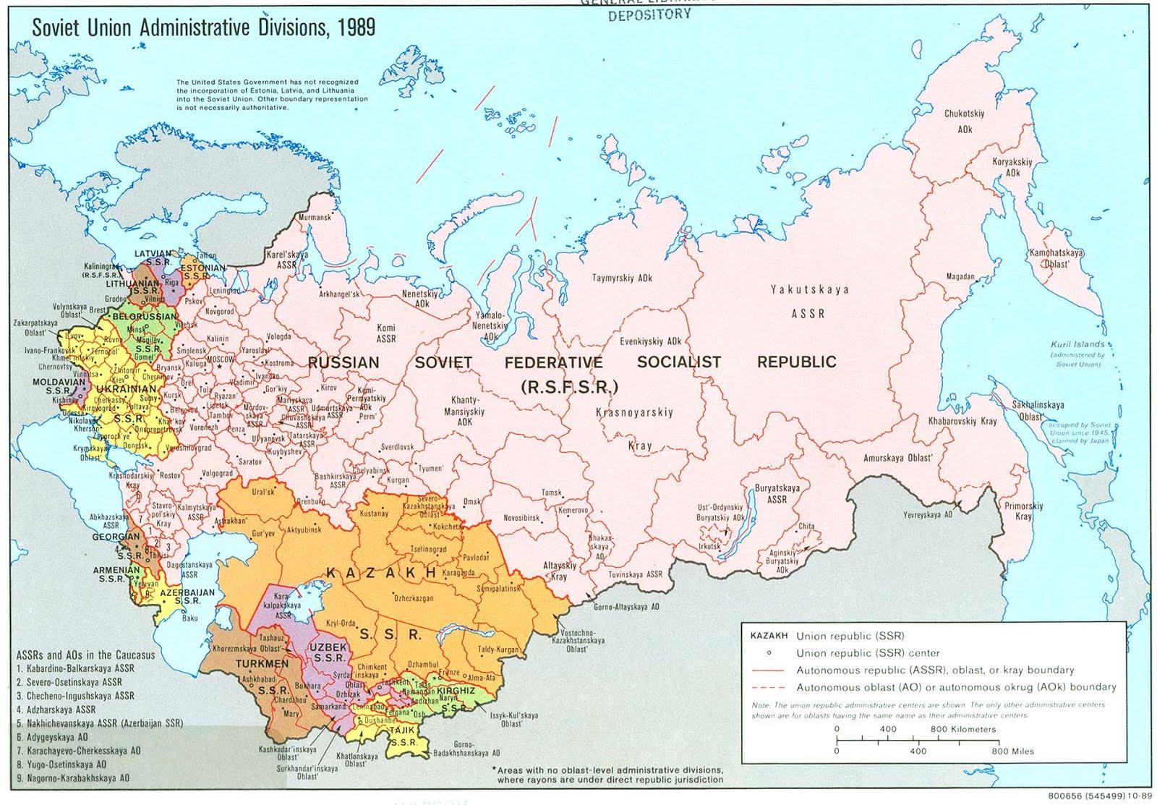
Baltic States:
Estonia
Latvia
Lithuania
East-Central Europe:
Belarus
Moldova
Ukraine
Southern Caucus:
Azerbaijan
Georgia
Armenia
Central Asia:
Kazakhstan
Kyrgyzstan
Tajikistan
Turkmenistan
Uzbekistan

Slide 8
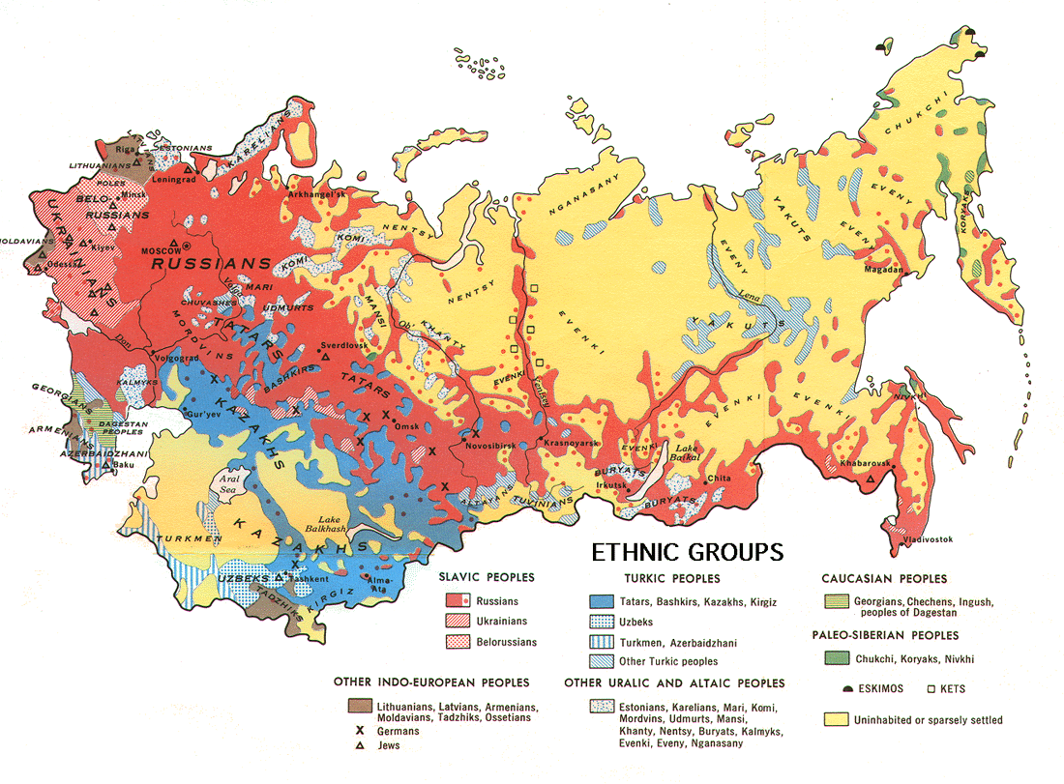

Slide 9
Overview of Post Soviet Conflicts
- Yugoslavia
- Moldova
- Armenia/ Azerbaijan
- Georgia
- Chechnya
- Ukraine

Slide 10
Breakup of Yugoslavia
The Yugoslav Wars were ethnic conflicts fought from 1991 to 1999 on the territory of former Yugoslavia.
The wars followed the breakup of the country, where its constituent republics declared independence, but the issues of ethnic minorities in the new countries, chiefly Serbian central parts and Albanians in the southeast, were left unsolved. The wars are generally considered to be a series of largely separate but related military conflicts occurring and affecting most of the former Yugoslav republics:
War in Slovenia (1991)
Croatian War of Independence (1991–1995)
Bosnian War (1992–1995)
Kosovo War (1998–1999), including the NATO bombing of Yugoslavia

Slide 11
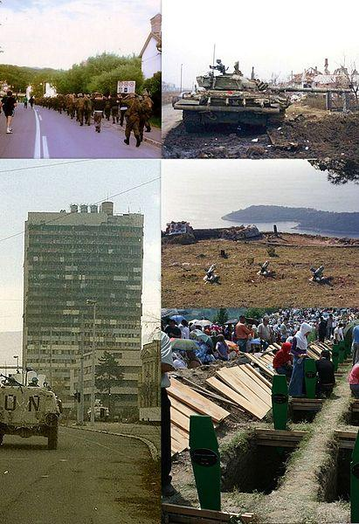

Slide 12
Yugoslav Wars 1991-1999
The Yugoslav People's Army (JNA) sought to preserve the unity of the whole of Yugoslavia by crushing the secessionist governments; however the JNA increasingly came under the influence of the Serbian government of Slobodan Milošević that evoked Serbian nationalist rhetoric and was willing to support the Yugoslav state insofar as using it to preserve the unity of Serbs in one state; as a result the JNA began to lose Slovenes, Croats, Kosovar Albanians, Bosniaks, and ethnic Macedonians, and effectively became a Serb army.
The conflicts have become infamous for the war crimes involved, including ethnic cleansing, crimes against humanity and rape. These were the first conflicts since World War II to be formally judged genocidal in character and many key individual participants were subsequently charged with war crimes. The International Criminal Tribunal for the former Yugoslavia (ICTY) was established by the UN to prosecute these crimes.
According to the International Center for Transitional Justice, the Yugoslav Wars resulted in the deaths of 140,000 people.

Slide 13
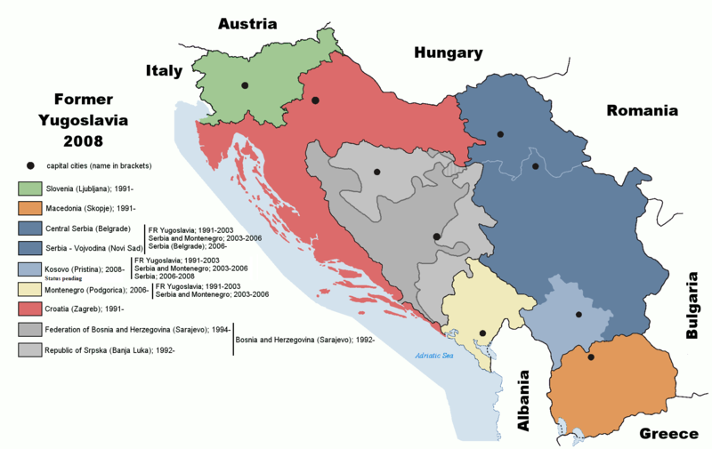
Wars in former Yugoslavia from 1991-1999

Slide 14
Moldova/ Transnistria 1990-1992
- Armed conflict erupts b/t separatists and Moldova in November 1990.
Volunteers arrive from Russia and Ukraine to support the pro-Russian separatists.
- In 1992 concerted military engagement takes between Moldova and Transnistria. The Russian Army enters the conflict in the final stage on the side of the Transnistrian Separatists.
- A ceasefire agreement was signed on July 21st 1992 and has held to the present day. Russian Federation continues to utilize Transnistria region as military hub with approx. 1,200 Russian soldiers based in territory.

Slide 15
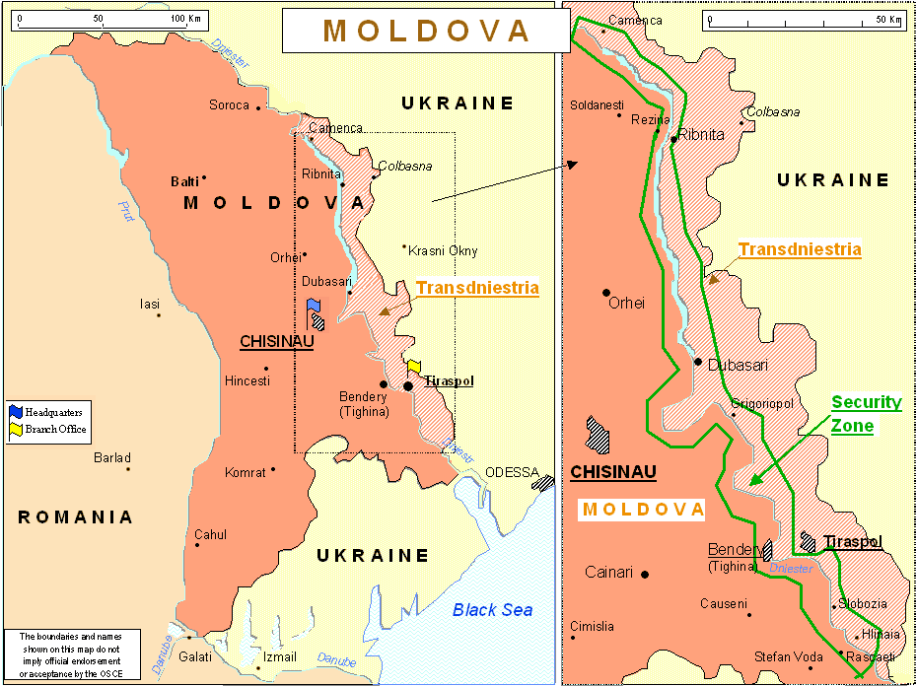

Slide 16
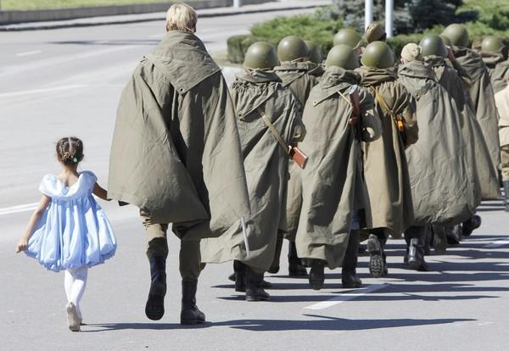

Slide 17
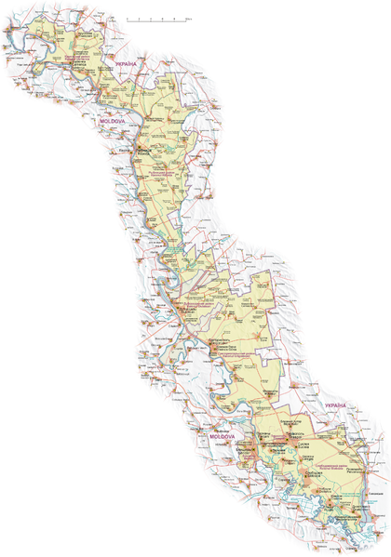
SEEKING ANNEXATION

Slide 18
Armenia/Azerbaijan 1992
Nagorno-Karabakh War b/t Armenia and Azerbaijan.
Full-scale fighting erupted in 1992.
International mediation including the Organization for Security and Co-operation in Europe (OSCE) failed to bring an end resolution that both sides could accept.
In 1993, Armenian forces captured regions outside the enclave itself, threatening the involvement of other countries in the region. By the end of the war in 1994, the Armenians were in full control of most of the enclave and also held and currently control approximately 9% of Azerbaijan's territory outside the enclave.

Slide 19
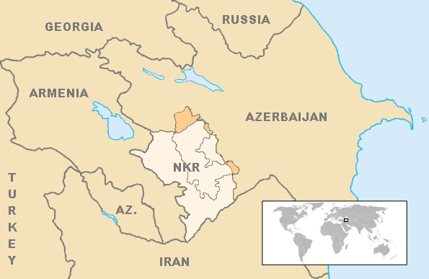
As many as 230,000 Armenians from Azerbaijan and 800,000 Azeris from Armenia and Karabakh have been displaced as a result of the conflict.
A Russian-brokered ceasefire was signed in May 1994 and peace talks, mediated by the OSCE Minsk Group, have been held ever since by Armenia and Azerbaijan.
RUSSIAN FEDERATION Brokered Ceasefire

Slide 20
Georgia 2008
- Armed conflict began in August 2008 b/t Georgia and Russia supporting the separatist governments in South Ossetia and Abkhazia.
- The 1991–92 South Ossetia War b/t ethnic Georgians and Ossetians had left more than a half of South Ossetia under de facto control of a Russian-backed, internationally unrecognized government.
- Most ethnic Georgian parts of South Ossetia remained under the control of Georgia, with Georgian, North Ossetian and Russian Joint peacekeeping force present in the territories. A similar situation existed in Abkhazia after the War in Abkhazia (1992–93).
- Increasing tensions escalated during the summer months of 2008.

Slide 21
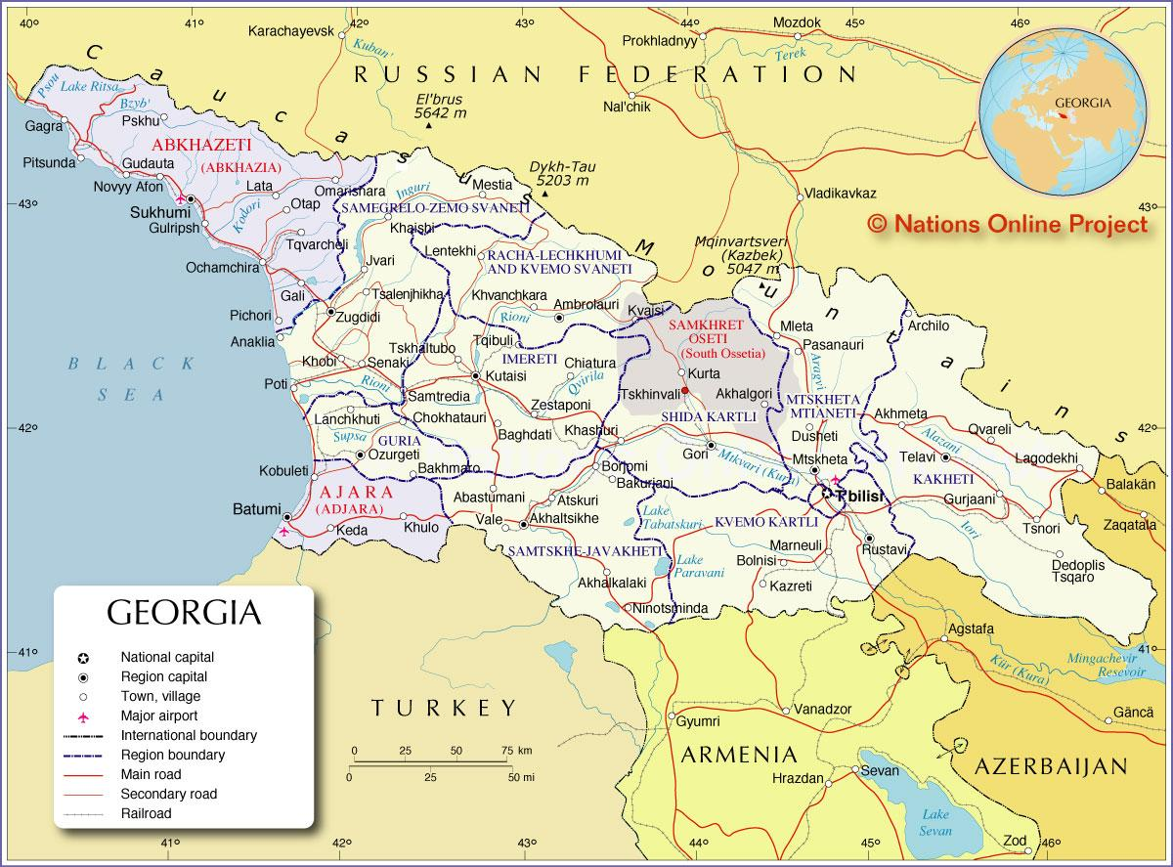

Slide 22
Georgia 2008
- Russia claimed these actions were a necessary humanitarian intervention and peace enforcement. Russian and Ossetian forces battled Georgian forces throughout South Ossetia for four days, the heaviest fighting taking place in Tskhinvali.
- Through mediation by the French presidency of the European Union, the parties reached a preliminary ceasefire agreement on August 12th.
- Russian forces remain stationed in Abkhazia and South Ossetia under bilateral agreements with the corresponding separatist governments

Slide 23
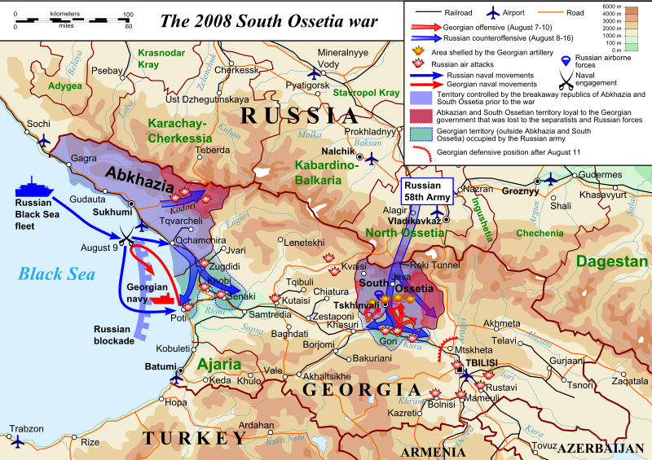

Slide 24
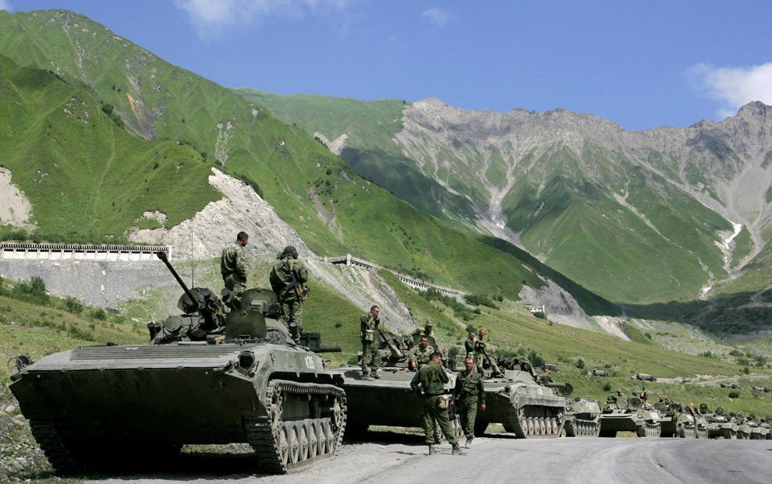

Slide 25
Chechnya 1994-1996
- The First Chechen War, also known as the War in Chechnya, was a conflict between the Russian Federation and the Chechen Republic of Ichkeria, fought from December 1994 to August 1996.
-After the initial campaign of 1994–1995, culminating in the devastating Battle of Grozny, Russian federal forces attempted to seize control of the mountainous area of Chechnya but were set back by Chechen guerrilla warfare and raids on the flatlands despite Russia's overwhelming manpower, weaponry, and air support.
- Widespread demoralization of federal forces and the almost universal opposition of the Russian public to the conflict led Boris Yeltsin's government to declare a ceasefire with the Chechens in 1996 and sign a peace treaty a year later.

Slide 26
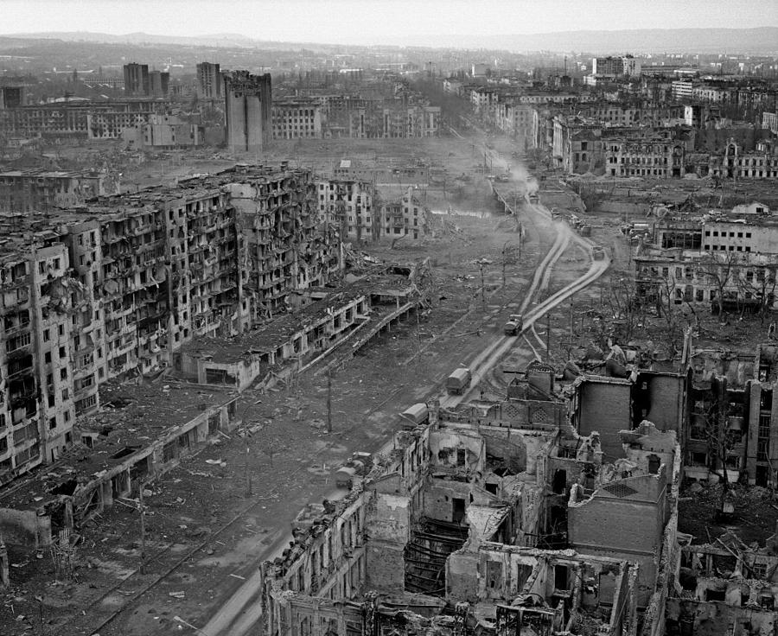

Slide 27
Chechnya 1996-1999
The official figure for Russian military deaths is 5,500, while most estimates put the number between 3,500 and 7,500, or even as high as 14,000. Although there are no accurate figures for the number of Chechen militants killed, various estimates put the number at about 3,000 to over 15,000 deaths.
Various figures estimate the number of civilian deaths at between 30,000 and 100,000 killed and possibly over 200,000 injured, while more than 500,000 people were displaced by the conflict, which left cities and villages across the republic in ruins.
The ruined country awash with warlords and firearms becomes a breeding ground for gangsters, Islamist radicals, and general profiteering off energy resources.

Slide 28
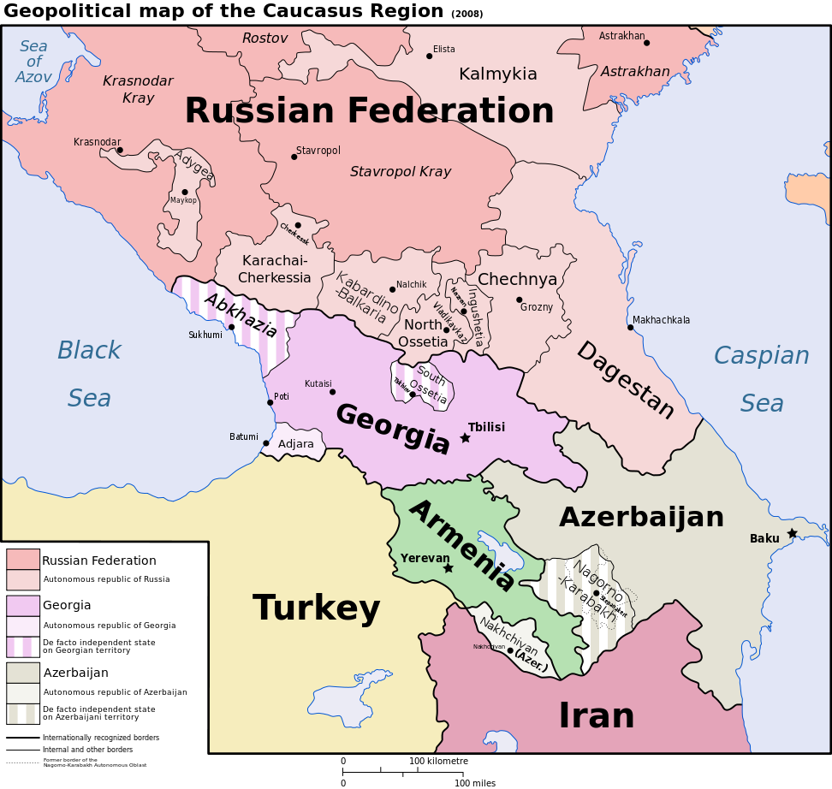

Slide 29
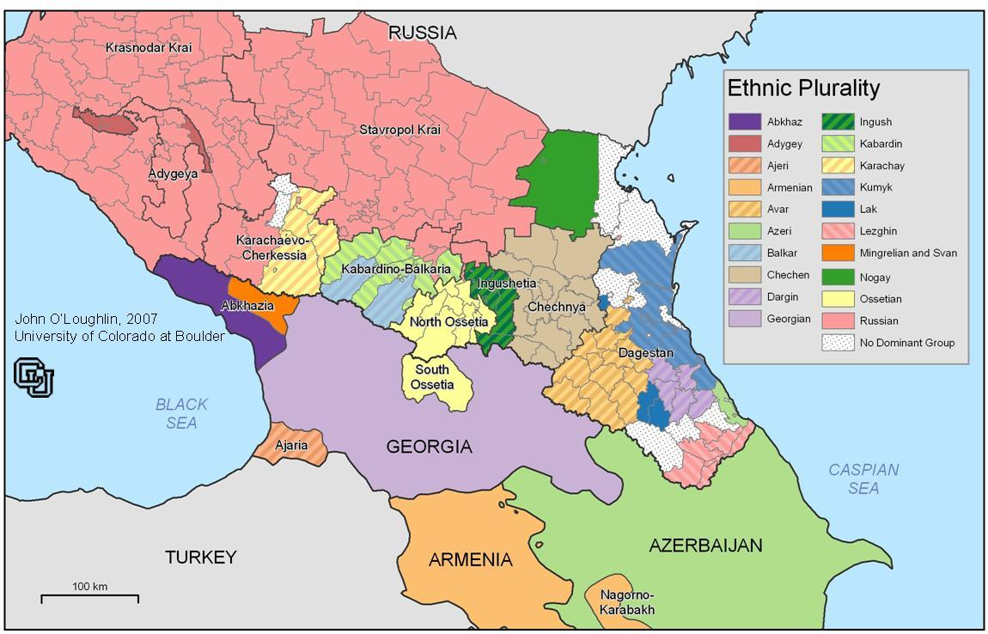

Slide 30
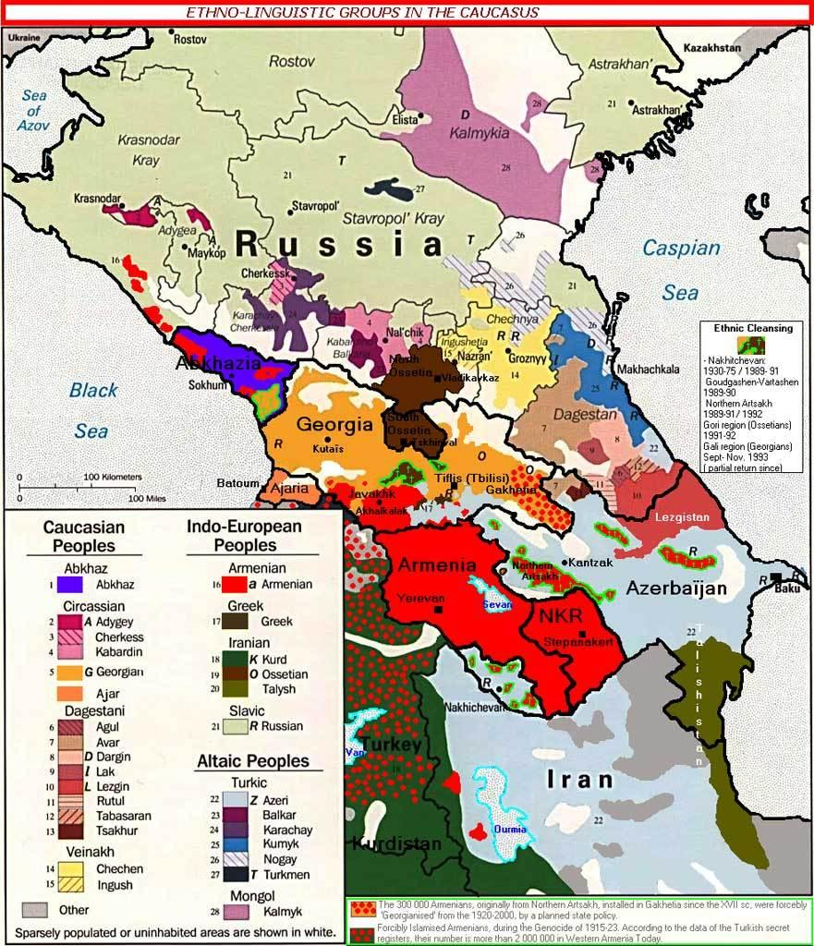

Slide 31
Chechnya 1999-2000
The Second Chechen War was launched by the Russian Federation starting 26 August 1999, in response to the Invasion of Dagestan by the Islamic International Peacekeeping Brigade (IIPB) and apartment block bombings inside of Russia.
On October 1st Russian troops entered Chechnya. The campaign ended the de facto independence of Chechen Republic of Ichkeria and restored Russian federal control over the territory.
Although it is regarded by many as an internal conflict within the Russian Federation, the war attracted a large number of foreign fighters.
The exact death toll from this conflict is unknown. Unofficial estimates range from 25,000 to 50,000 dead or missing, mostly civilians in Chechnya. Russian casualties are over 5,200 (official Russian casualty figures) and are about 11,000 according to the Committee of Soldiers' Mothers.

Slide 32
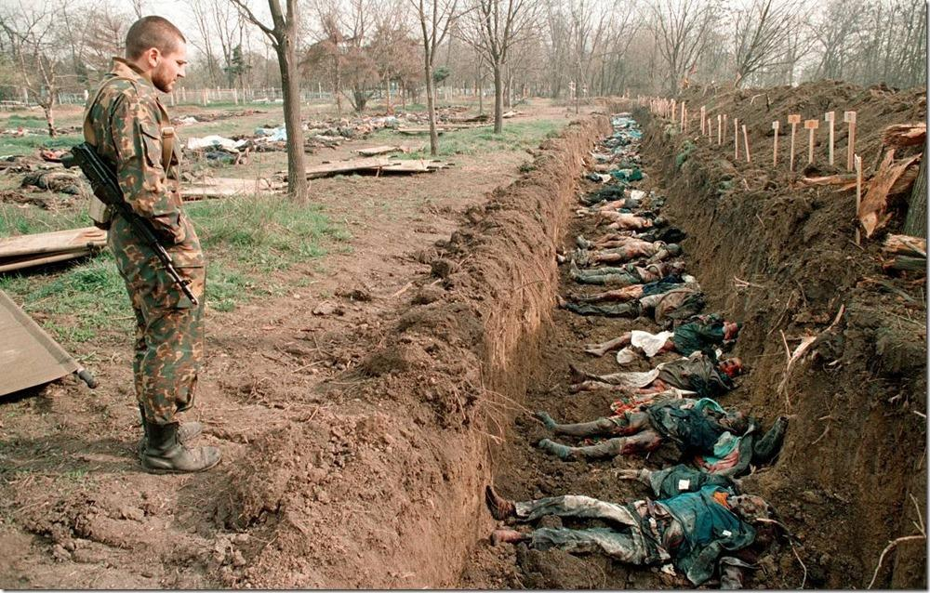

Slide 33
Chechen Jihad 2001-2009
During the initial campaign, Russian military and pro-Russian Chechen paramilitary forces faced Chechen separatists in open combat, and seized the Chechen capital Grozny after a winter siege that lasted from late 1999 to the following February 2000.
Russia established direct rule of Chechnya in May 2000 and after the full-scale offensive, Chechen militant resistance throughout the North Caucasus region continued to inflict heavy Russian casualties and challenge Russian political control over Chechnya for several more years.
Numerous documented instances of Russian War crime have been uncovered.
Some Chechen separatists also carried out numerous terrorist attacks against civilians in Russia. These attacks, as well as widespread human rights violations by Russian and separatist forces, drew international condemnation.

Slide 34
Moscow Hostage Crisis 2002
The Moscow theater hostage crisis, also known as the 2002 Nord-Ost siege, was the seizure of the crowded Dubrovka Theater on 23 October 2002 by 40 to 50 armed Chechens who claimed allegiance to the Islamist militant separatist movement in Chechnya. They took 850 hostages and demanded the withdrawal of Russian forces from Chechnya and an end to the Second Chechen War. The siege was officially led by Movsar Barayev. After a two-and-a-half day siege, Russian Alpha Group forces pumped an undisclosed chemical agent into the building's ventilation system and raided it.
During the raid, all 40 of the attackers were killed by Russian forces, and about 130 hostages died due to adverse reactions to the gas. All but two of the hostages who died during the siege were killed by the toxic substance pumped into the theater to subdue the militants. The use of the gas was widely condemned as heavy-handed, but the American and British governments deemed Russia's actions justifiable. Physicians in Moscow condemned the refusal to disclose the identity of the gas that prevented them from saving more lives. Some reports said the drug naloxone was successfully used to save some hostages.

Slide 35
Beslan 2004
On September 1, 2004, a group of 32 heavily armed, masked men seized control of Middle School Number One and more than 1,000 hostages in Beslan, North Ossetia. Most of the hostages were children aged from six to sixteen years old. Following a tense two-day standoff punctuated by occasional gunfire and explosions, Alpha Group of the FSB raided the building. The fighting lasted more than two hours; ultimately 331 civilians, 11 commandos and 31 hostage-takers died.

Slide 36
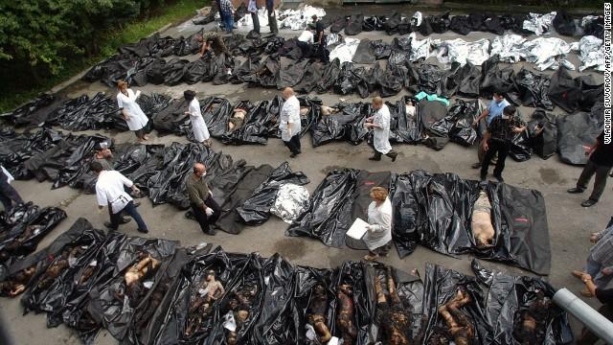

Slide 37
Ukraine/Crimea 2014
2013
EU trade agreement abandoned
Euromaidan
2014
brief lull in Independence Square
political change does not come fast enough
Feb 20th most violent day, snipers kill ca. 70 protesters
Feb 21st Yanukovich flees Ukraine, interim government
Mar 1st Crimea under control of Russian troops
Mar 16th Referendum
Today NATO & Ukraine warning of Russian troop build-up on Ukrainian-Russian Border

Slide 38
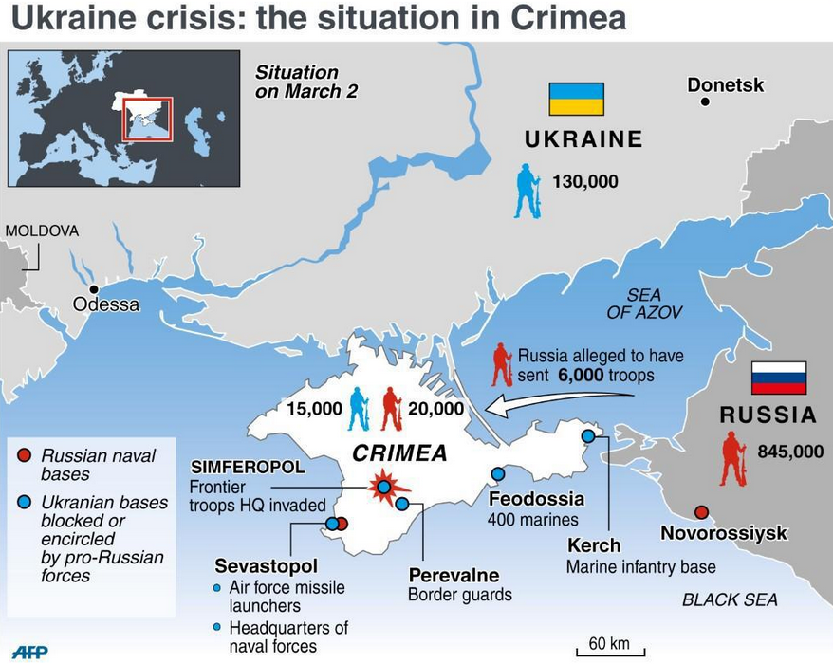

Slide 39
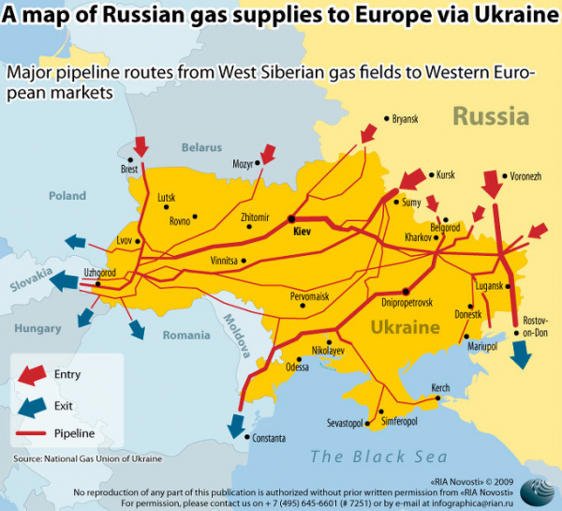

Slide 40
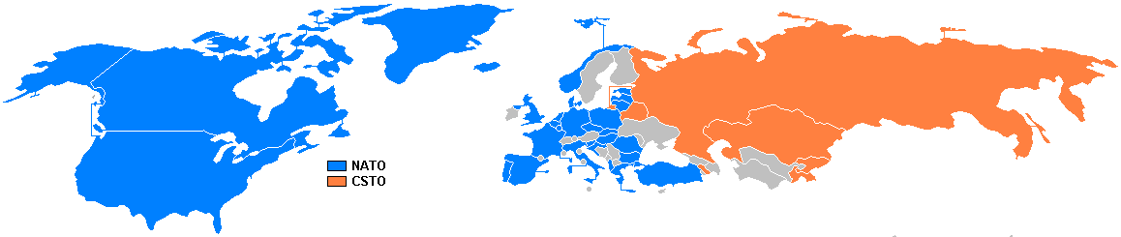

Slide 41
Principal Global Actors:
Russian Federation/ CSI Alliance
US-EU/ Nato Alliance
Ukraine
Tarter minority of Crimea
14 other former Soviet nations
Ripples in Regional Hegemony
China, India, Brazil, South Africa (BRICS)
North Korea/ Syria
Japan/ Israel / Turkey

Slide 42
Fitzduff Ethics and Lempereur Trumps
As peace builders, what are some of the ethical challenges we face in the Crimean crisis? How should we approach the situation? How can we be prepared?
Be clear about what we are doing: Conflict Dialogue work, agreement- seeking connections between and within Russia and Ukraine. We may increase connections but fail to have difficult conversations about power, equality, and national allegiance for a sustainable solution.

Slide 43
Fitzduff Ethics and Lempereur Trumps
PEOPLE: WHO we engage (Stakeholders, Relationships, Mandates)
Do not assume that the contestants are irrational
Do find local and respected partners
PROCESS: HOW we engage (Methods, Questions, Communication)
Be responsible about the possible effects of your work. Must be prepared going in, able to debrief, and provide follow up
Do use experiences and examples of what has been useful elsewhere.
Be open to and examine opportunities not linked to the armed conflict.

Slide 44
Fitzduff Ethics and Lempereur Trumps
PROBLEM: WHAT we engage (Motivations, Justifications, and Solutions)
Be faithful to the work
Do not think the work is about solutions
Do not assume there is no capacity for conflict management or peace building
Do not expect that you can usually achieve a just agreement

Slide 45
Simulation Time!

Slide 46
BRICS as Mechanism for Peace:
Diffusing the military clashes with economic cooperation, diversity of funding.
The BRIC(S) could become the four largest economies by 2050 (Jim O’Neill, Goldman Sachs global economics)
Political block created in 5/16/2009, summits held Brasilia 2010, Sanya 2011, New Delhi 2012. Calling for multipolar world order.
25% world land, 40% world’s population, combined GDP 20 trillion dollars.
BRICS development bank created March, 2013

Slide 47
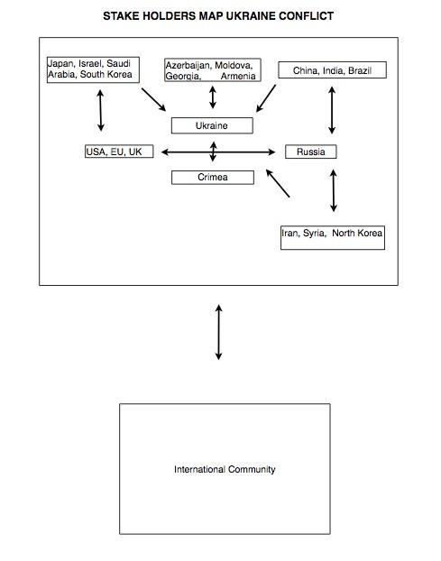

Slide 48
Strategic Recommendations
1. BRIC Multipolarity Recommendations
- Acceptance and strategic embrace of multipolar world order.
- Multilateral aid and development from China, Brazil, India, South Africa
- Recognition and participation of Russian Sphere
2. Guarantees on Tartar Minority Rights
- Systematic protocols for secessionist struggles, autonomy, and clearer pathways to protect minority populations from harm.
- Give UN greater multilateral peacekeeping enforcement powers.
3. Treates specifying clear international protocols for succession
- Clear recognition that that nation state is not a finite entity.
- Clearer resources to federalism without force.
Potential Role of the OSCE
Notes:
http://www.reuters.com/article/2014/03/21/us-ukraine-crisis-osce-idUSBREA2K1J220140321
http://www.osce.org/odihr
https://www.osce.org/cio/116710

Slide 49
Strategic Recommendations
4. The Crimea contains a vital Russian military asset and it will not change hands. Far greater predictive planning and mitigation must be in place to anticipate the real thresholds of the Russian Federation’s territorial ambitions.
5. The Crimean Tatars must have their rights guaranteed.
6. Every effort must be made to preserve Ukrainian territorial integrity via multi-polar development and aid. Countries must work to move past the Cold War paradigm of geo-politics.
7. It must be clearly understood that territorial integrity is a great deal less important than minority rights.

