Slide 1
Analysis of the Conflict for Kurdistan
Stateless in Developing, Devolving, War Torn & Occupied States

Slide 2
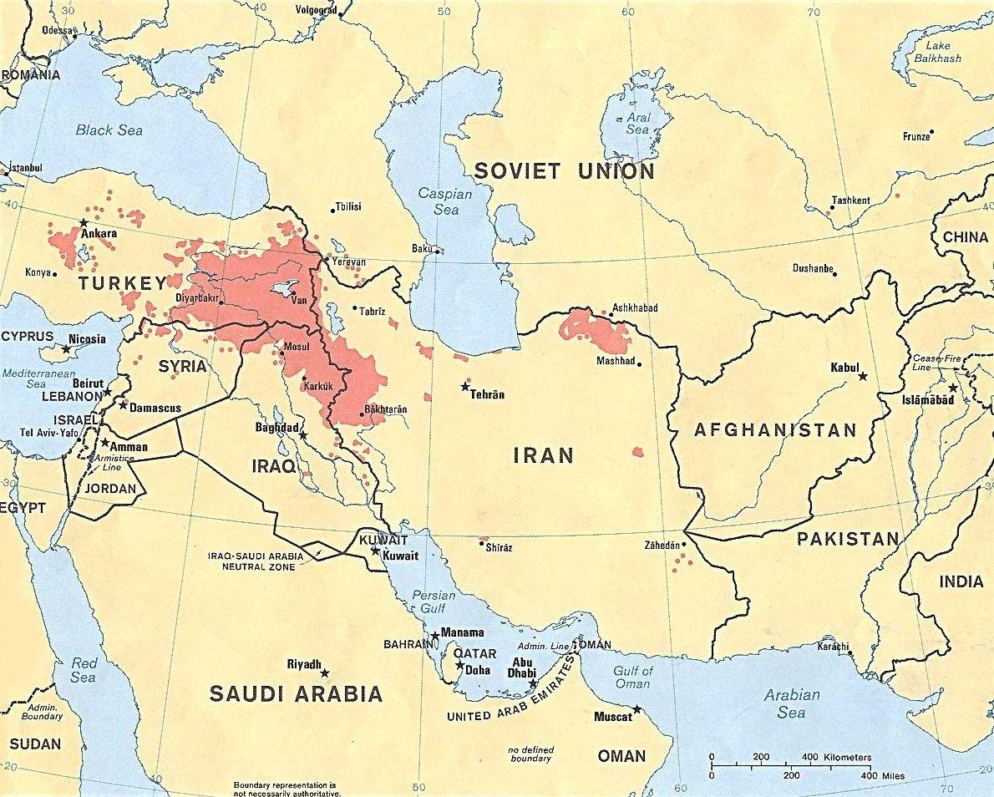

Slide 3
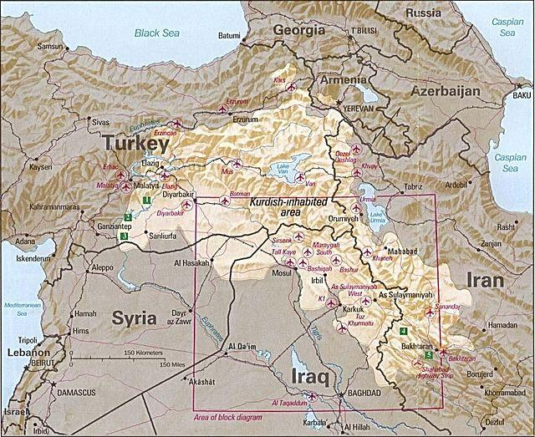

Slide 4
Leading Analysis Questions
Who are the Kurds?
What are their quad-national aspirations?
What is their impact and influence on Middle Eastern conflict?
What kinds of outcomes are likely?

Slide 5
Who are the Kurds?
The Kurds are the largest ethnic group that do not yet have their own state.
25-30 million, mostly Sunni Muslims but minorities include Shia, Alawite, Alevi, Yazidi
Divided amongst Turkey, Iraq, Syria and Iran.
1.3 million live in Western Europe, 150,000 Jews of Kurdish origin live in Israel.

Slide 6
Who are the Kurds
The origin of their name is unclear but is one of the oldest surviving ethnic designations
Kurdish has 2 main dialects, (SORANI) Korani and (Kurmanji) Soranji. Most Kurds also speak a national language such as Arabic, Arameic, Farsi, or Turkish and in diaspora a third language.
The Kurds began conversion to Islam in the 7th century.

Slide 7
Who are the Kurds
Kurdish general Saladin defeated the Christian Crusaders in 1187.
With the collapse of the Ottoman Empire the Kurds were arbitrarily dispersed between four areas.
With the escalation of “Cold War” and the “War on Terror” Kurds see new opportunities and threats.

Slide 8
What do the parties see as the sources of the Conflict?
Each of the four states seeks to preserve their territorial integrity by any means necessary.
The Kurdish population of all four countries seek guarantees for their human rights, but are divided amongst themselves nationally, politically, culturally, and tribally while being directly stifled in their aspirations for statehood.

Slide 9
What do the parties see as the sources of the Conflict?
Iraqi Kurdistan has enjoyed de-facto independence since the collapse of the Iraqi state after the American invasion of 2003. The Kurdish people of Iraq were subjected to a genocide in 1987-1988 which slaughtered over 1.5 million people.
Iranian Kurdistan is largely quiet on the subject of independance thanks to a combination of Iranian acceptance of Kurdish rights and a strong state security apparatus.
Turkish Kurdistan is highly divided on the issue of statehood but fields the second largest armed formation of Kurds the PKK.
Syrian Kurds are currently caught in the crossfire of ISIS expansion and the Syrian civil war.

Slide 10
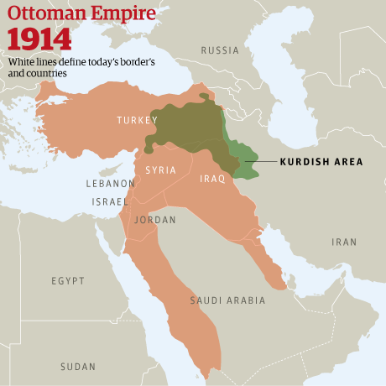

Slide 11
Sykes-Picot Agreement
- Sykes – Picot 1916 agreement between France and England dividing the former Ottoman empire into manageable colonies.
- Artificial boundaries effect on the division of different ethnic groups especially Kurds

Slide 12
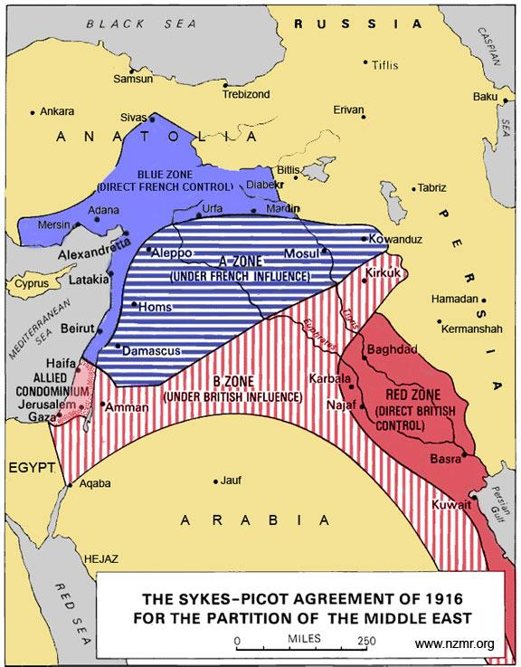

Slide 13
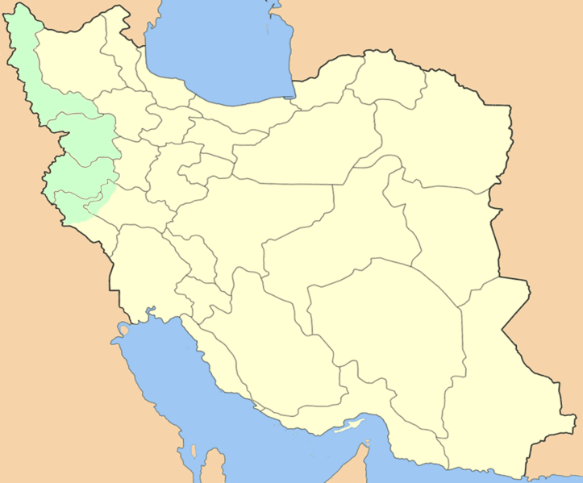
Kurds in Iran
Notes:
roughly 7 million Kurds living in Iran, 5 million are Sunnis

Slide 14
Basic Data Set: (Iran)
Country Kurdish population: roughly 7 million, 5 million Sunnis
Leading Figures: (ABDULRAHMAN QASIMLO? ) Mustafa Hijri, General Secretary of the 14th PDKI
Leading Factions: PDKI, promoter of federalism in Iran, seeks Kurdish national rights within Iranian national context
PJAK, an offshoot of the Turkish PKK, seeks Kurdish emancipation and seen by Iran as terrorist organization
Status of Autonomy: No autonomy, fighting for cultural recognition
Conflict Status: Mainly peaceful, except for PJAK. Trying to be heard through the political process.

Slide 15
History of the Kurds in Iran
- Post WWI, the loose Iranian political system allowed Kurds to consolidate Kurdish Tribal authority
- In 1925, Shah Reza centralized authority leading to confrontation with Kurdish tribal authority. This resulted in assassination of Kurdish leader Simko in 1930 and rise of Kurdish nationalist movement.
- WW2 and the establishment of the Society for the revival of the Kurds/ Kurdistan (Komalay Jiyanaway Kurd/Kurdistan JK) 1942 then the Kurdish Democratic Party KDP 1945

Slide 16
History of Kurds in Iran
- Establishment and defeat of the Mahabad Republic of Kurdistan 1946
- KDP seeking official recognition after 1953 coup and Iranian government oppression against Kurds who fled to Iraq
- Iranian and Iraqi Kurds relationship in times of war and peace between Iran and Iraq

Slide 17
Kurds in Iran
- Iranian Kurds internal conflicts over power and representation
- Iranian Kurds and the Islamic revolution
- Iranian Kurds during Khatami’s presidency

Slide 18
Current Kurdish Situation in Iran
- Iranian Kurds during Ahmadinejad’s presidency
- Main constraints to Iranian Kurdish mobilization

Slide 19
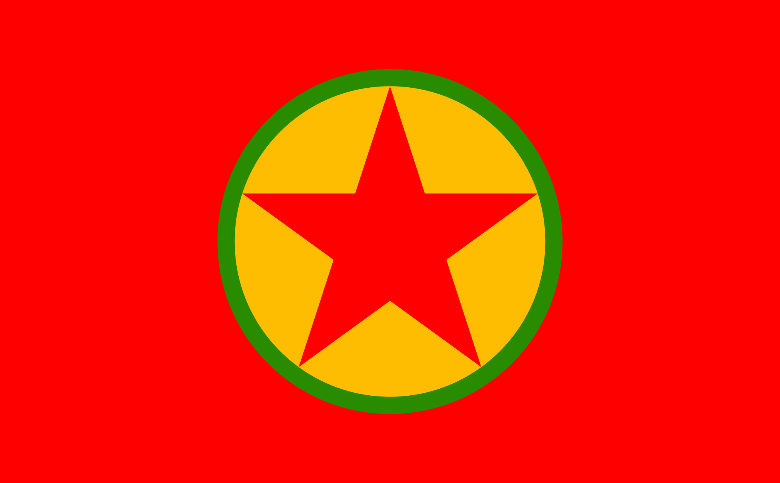
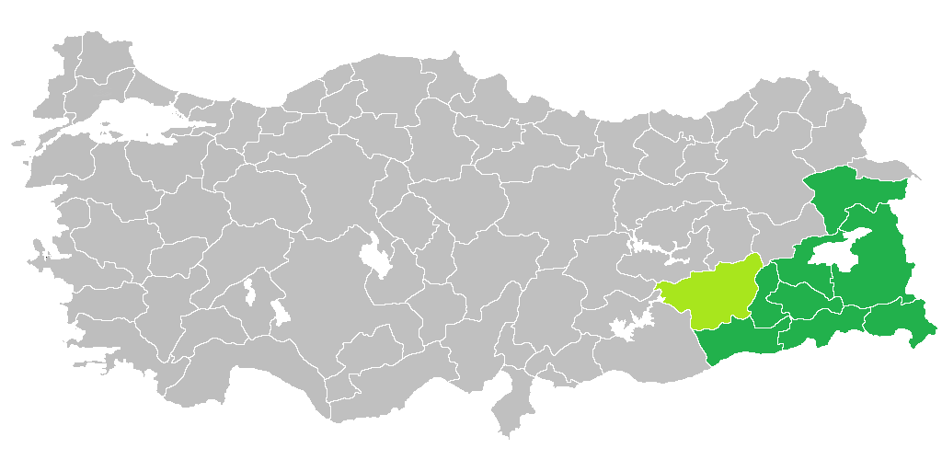
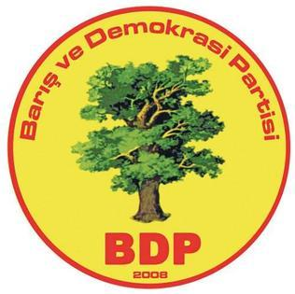
Kurds in Turkey

Slide 20
Basic Data Set: (Turkey)
Country Kurdish population: roughly 14-25 million (15-25% of population)
Leading figures: Abdullah Ocalan (PKK), Leyla Zana (HDP/ BDP)
Leading Factions: PKK, promoter of separatism/ socialism in Turkey, seeks Kurdish national rights via parallel state structures and armed struggle. Peace and Democracy Party/ Democratic Regions Party has 1 parliamentary candidate/ 103 municipal
PKK Has established an umbrella parallel state in all four territories.
HDP has attempted to elect pro-Kurdish rights candidates to Turkish parliament.
Status of Autonomy: No autonomy, heavily militarized South East region via army and Home Guards; ceasefire in guerilla war in 1999. IN 2010 more fighting broke out. Fighting for cultural recognition: proposals for Confederal system across four countries.
Conflict Status: Mainly peaceful, except for PKK strikes in Iraq. Trying to be heard through the political process while refusing to disarm PKK.

Slide 21
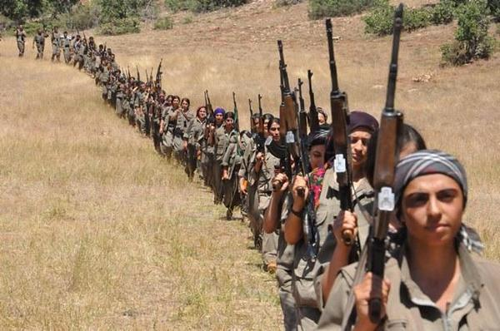

Slide 22
History of Kurds in Turkey
Between 1937-1938 50-70,000 Kurds were killed in a forced resettlement campaign for Turkification of the country. This is called the Dersim Massacre/Revolt
In the 1970’s Kurdish separatists in Turkey formed the Kurdish Workers Party (PKK), a Marxist Leninist organization that engaged in guerrilla warfare with the Turkish government from 1978 until 1999.
The Turkish government responded with severe human rights violations.
In the 1990’s this devolved into mutual targeting of civilians via terrorism/ paramilitaries.
In 1991 Leyla Zana was elected to Parliament. In 1994 she was imprisoned until 2004. In 1999 the Turkish government captured the leader of the PKK; Abdullah Ocelan.In 2008 Leyla Zana was again arrested and sentenced to two years in prison.
In 2011 the government again barred and arrested electoral candidates supposedly connected with the PKK triggering violent demonstrations.

Slide 23
Conflict Factors in Turkey
Even speaking Kurdish was illegal until 1991
370,000 Kurds have since been displaced and 3,000 villages wiped off the map. 40,000 people have been killed in Turkey with the 1990’s exhibiting terrorism targeting Turkish civilians & paramilitary violence and covert operations targeting Kurdish civilians.
Turkish refusal to support the besieged Syrian Kurdish city of Kobane triggered mass violent demonstrations on 7 Oct, 2014.

Slide 24
Conflict Factors in Turkey
Secret peace deals with PKK have stalled.
On 13 October, 2014 the Turkish Air force bombed PKK positions along the Iraqi/Turkish border.
Iraqi Kurdish leader Barzani relies on Turkish tacit support for the Autonomous Region.
Syrian Kurdish fighters in the Democratic Union Party (PYD) holding Kobane are a likely candidate for US arms and tactical support against ISIS. PYD is the Syrian arm of the PKK.
Ocalan calls for demilitarization. His relevance and agency are being questioned.

Slide 25
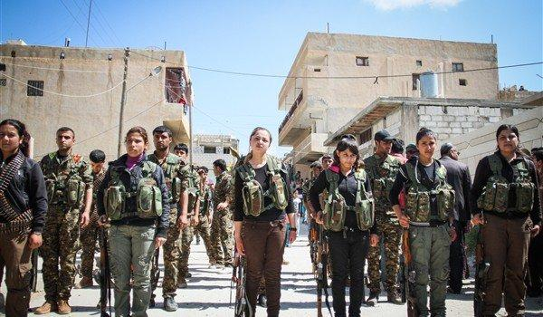

Slide 26
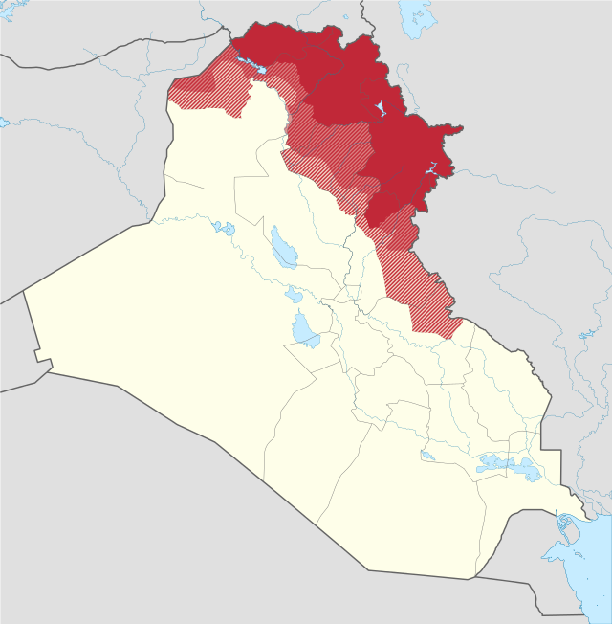
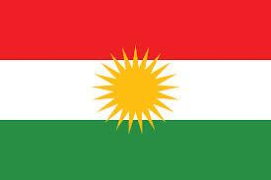
Kurds in Iraq
Notes:
The Zagros Mountains has served as a buffer zone to keep out Turks, Persians and Arabs and has allowed Kurdish culture in this region to flourish.The main Kurdish characteristic of the flag is the blazing golden sun emblem (called a "Roj") at the center, which is an ancient religious and cultural symbol among the Kurds and synonymous with fire in representing wisdom in Zoroastrianism and Yezidireligion. The sun disk of the emblem has 21 rays, equal in size and shape. The number 21 holds importance in the ancientYazdani religious traditions of the Kurds.^{[4]}
The symbolism of the colors are:
Red symbolizes the blood of martyrs of Kurdistan and the continued struggle for the freedom and dignity for Kurdistan and its people.
Green expresses the beauty and the landscapes of Kurdistan.
White expresses peace, equality and freedom for all those who live in Kurdistan no matter of ethnicity or religion.
Yellow represents the source of life and light of the people, while the sun represents the ancient Kurdish religion Yazdanism ^{[5]}

Slide 27
Basic Data Set: (Iraq)
Country Kurdish population: 5.2 million
Main Dialect: Sorani using Arabic script
Leading Figures: Masoud Barzani (KDP) President since 2005; his nephew Nechervan Barzani serves as Prime Minister; Jalal Talabani (PUK), IMK (Islamic Movement of Kurdistan)
Leading Factions: 3 major tribes, Barzanis, Baradost, and Zebari; Major political parties include PUK & PDK and newer Gorran List
Status of Autonomy: Autonomous region of Iraq governed by 111 member regional governing council, and also represented within the Iraqi Governing Council.
Conflict Status:
As the conflict rages in Iraq, the Kurds are currently fighting with ISIS. The outcome will likely determine Iraqi Kurdistan’s status within Iraq.
Notes:
This differs from the Kurds in Turkey who write using latin script;

Slide 28
The History of the Kurds in Iraq
-Treaty of Sevres in 1920 at the end of WWI , abrogated by the Treaty of Lausanne in 1923
- Iraqi independence in 1932, League of Nations membership contingent on protection of Kurdish civil and political rights
-1935, first political revolt by Kurdish chiefs
-Emergence of Mustafa Barzani, Kurdish revolt of 1943-1945
-Mahabad republic formed in 1945, Iraqi KDP formed at the same time
Notes:
Treaty of Sevres would have granted Kurds an independent state following WWI. However, in 1923, after revolution in Turkey, Kurdish areas in Turkey ended up coming under control of Turks and King Faisal in Iraq convinced Brits to give him Iraqi Kurdistan section. This was the beginning of many failed promises and betrayals.

Slide 29
History of the Kurds in Iraq
-Iraqi revolution of 1958 brought high expectations
-Barzani and exiled Kurd leaders were allowed to return
-Quickly became evident that free officers would not accept any form of Kurdish autonomy
-Ba’ath party takeover in 1963
-Began process of Arabization which continued until overthrow of Saddam Hussein in 2003
Notes:
Ba’ath party was essentially Arab nationalist party. The mere existence of Kurds in Iraq did not fit with the image of the dominant Arab rebuilding Mesopotamia that Saddam was trying to sell. Hostilities led to the Kurdish militia, the Peshmerga essentially taking over the Iraqi Kurdistan region, and a bombing campaign by the Iraqi government that continued through 1975

Slide 30
History of the Kurds in Iraq
In 1972, Iraq signed Friendship Pact with USSR
Cold war put Kurds right in the middle of power struggles between Iraq, USSR and U.S., Iran, Israel
Signing of the Algiers Agreement in 1975
1975 through 1980’s marked by power struggle between KDP’s Massoud Barzani and PUK’s Jalal Talabani
Notes:
The Kurds were funded and armed by the Iranians, but in 1975 Iraq and Iran signed peace treaty. The Iranians pulled all support for the Kurds and the Kurds were crushed by the Iraqi military. They created a buffer around Iraqi Kurdistan resulting in the destruction of 1500+ Kurdish villages.

Slide 31
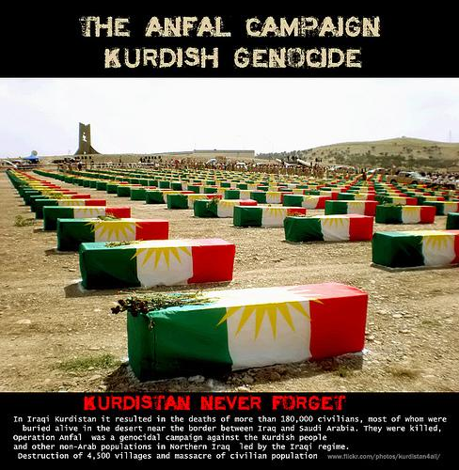

Slide 32
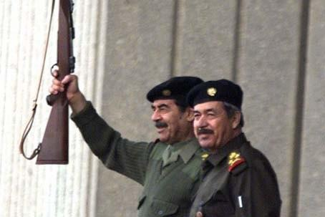
Anfal Campaign
-Series of eight military offensives by Ba’athist against Iraqi Kurds between 1987-1988
-Took place within backdrop of Iraq/Iran war
-Destruction of 3,000 villages, displacement of 1.5 million, 180,000 killed including mass executions of civilians
Notes:
Basic policy of war between Iraq and Iran. Saddam feared, perhaps rightfully so, that the Kurds would side with Iran. Talabani was labeled as an agent of Iran. Saddam appointed his cousin, ‘Ali Hassan al-Majjid aka Chemical Ali to control northern bureau. Relocations, chemical attacks, systematic disappearances, genocide. Turkey denied Kurds entry in Turkey at the time based on fears of own insurrection of their Kurds. Iran allowed 100,000 Kurds into the country.

Slide 33
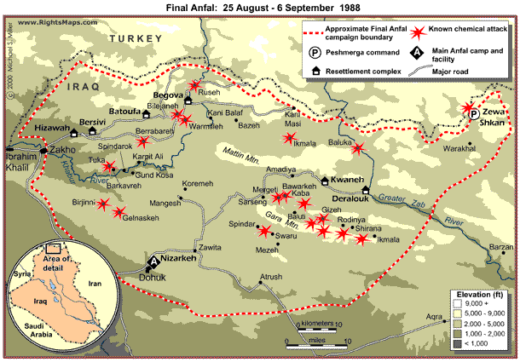

Slide 34
The Gulf War and the Kurdish Intifada
-With Iraqi army tied up in Kuwait, Kurds staged large scale rebellion in March 1991
-Early success, but crushed by Saddam in April
-fear of renewed chemical attacks led 2 million Kurds to flee to Turkish and Iranian border
Notes:
Erbil, Kirkuk and whole northern region was seized by mix of Peshmerga and roughly 60,000 Iraqi soldiers who switched sides. U.S. did not support Kurdish and Iraqi army insurrection. It’s thought that they did not want to see Iraq broken up. It would have made region unstable and they needed to heed Turkey’s wishes as they were NATO members.

Slide 35
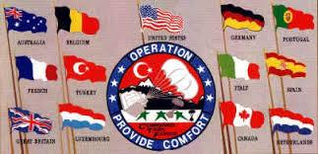
Iraqi Kurdistan post-Gulf War
-Operation Provide Comfort
-Saddam forced to pull troops, places economic embargo
-May 1992, first free elections saw PUK & KDP nearly split
Notes:
U.S. and allies implemented No-fly Zone. Saddam’s army were easy prey for Peshmerga in the mountains without air support. Saddam forced to pull troops. Barzani was more moderate, for autonomy. Talabani wanted independent Kurdistan. They bargained and made the goal to be a federation within a unified Iraq.

Slide 36
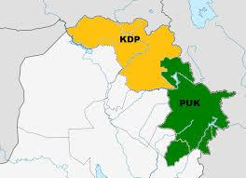
Power struggles of the 1990’s
-KDP and PUK essentially created dual governments
-Hostilities began in 1994, roughly 2000 people killed between 1994 and 1996
-KDP vs. Turkish PKK
Notes:
Poor economic situation opened up the door to ethnic, tribal, religious warfare. PUK was supported by Iran, KDP had ties to Turkey. PKK was attacking Turkey from Iraqi Kurdistan. Iraqi Kurds and Turkish troops acted in unison to destroy PKK peshmerga.

Slide 37
Kurdish Civil War
-Full fledged civil war in 1996
-KDP vs. PUK
-Barzani worked with Saddam to oust KDP (PUK) control
-Turkey, U.S. mediated ceasefire in 1996; relative peace and statebuilding proceeded with U.S. assistance
Notes:
Barzani asked Saddam for help in vanquishing PUK, and accused Talabani as being a tool of Iran. Reconciliation in 1998 led to statebuilding efforts.

Slide 38
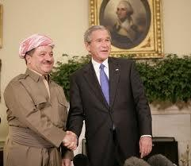
Operation Iraqi Freedom
-Prior to invasion, Kurds already had quasi-state; invasion solidified autonomy
-Peshmerga opened a northern front against Saddam, instrumental part of American strategic planning
-New Iraqi Constitution of 2005 gave Kurds full autonomy in Kurdish region
-Since fall of Saddam, Kurdistan has been most stable, war-free region of Iraq
Notes:
Turkey did not let U.S. use bases from north of Iraq, so Peshmerga cooperation was essential. George W. Bush with Massoud Barzani, something unthinkable prior to the invasion of Iraq. Constitution made Kurdish language official, allowed Kurds to open embassies abroad,

Slide 39
Iraqi Kurdistan in new Iraq
-Iraqi constitution plus U.S. support gave Kurds much power within Iraq, Talabani became president of Iraq in 2005
-Disputes with Al-Maliki government, especially over status of Kirkuk (10% of Iraqi oil reserves)
-Kurds want to control oil resources but have historically been dependent on Iraq’s national pipeline grid
-By 2007, Kurds had formed oil deals with companies from Turkey, UAE, U.S., U.K., Austria and more; deemed “illegal” by government in Baghdad

Slide 40
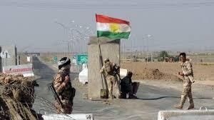
Kurds and the Current state of Iraq
-The fall of Mosul to ISIS and the quick dissolution of the Iraqi army threatens Kurds, while simultaneously creating opportunities
-The recent capture of Kirkuk in June 2014 brings Kurds closer to full independence
-In July, 2014 Barzani ordered the parliament to
begin proceedings for a vote on self-rule. Spokesman for
leading party in Turkey came out in support of independence
-August 2014, U.S. supplied Kurds with weapons, airstrikes against ISIS fighting on border of Kurdish region. Thin line since U.S. favors unified Iraq. Kurds have not incurred major strategic losses due to ISIS. Hopes are as high for independence, as Iraq crumbles.

Slide 41
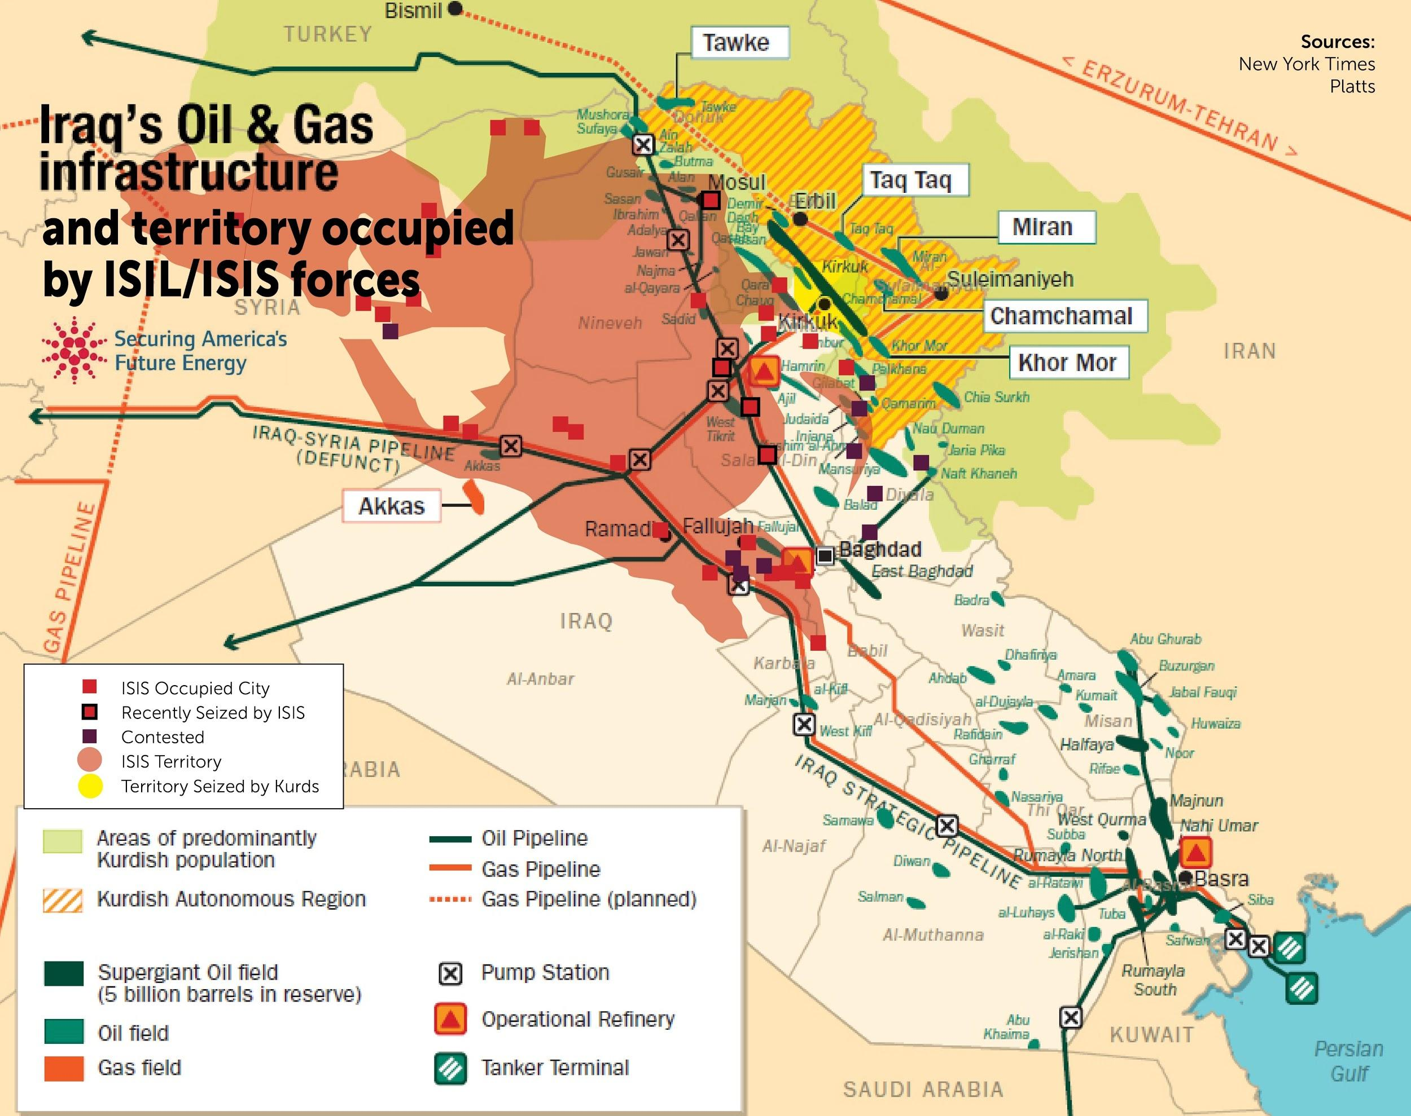

Slide 42
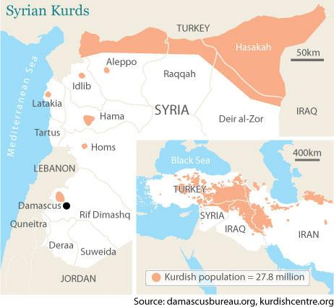
The Kurds in Syria
Country Kurdish population:
- roughly between 2 – 2.5 million
-some 300,000 of them remain stateless
-Urban – Rural divide
-Religious divide
-Linguistic differences: Sorani – Karamanji
Leading Figures:
-Partiya Yekîtiya Demokrat (Democratic Union Party,PYD), YPG armed forces -
-Kurdish National Council (KNC)
- Kurdish Youth Committees.
Status of Autonomy:
- North-Eastern Syria – Syrian Kurdistan , PYD controlled the area with support from one Arabic tribe – Al-Assad Regime
Conflict Status:
A War Torn Zone with many stakeholders:Turkey – Iran – IS – Al-Assad Regime – Non- Kurdish Syrian Opposition (Free Syrian Army, FSA) – Iraqi-Kurdistan

Slide 43
History of Kurds in Syria
French Mandate: (1920 – 1946) The Republic
-Joined the Army
-1931 election - Three members of Syrian Kurdish nationalist.
-Autonomist movement : Kurds - Syriac Catholic - Armenian Catholic.
-The Kurdish-Christian Coalition wanted French troops to stay.

Slide 44
History of Kurds in Syria
Syrian Mandate: (1946- 1970) The Shoeshiner
-1957: Kurdistan Democratic Party of Syria (KDPS).
-1958: Union with Egypt.
-1961: Syria was declared an Arab Republic in the interim constitution.
-1962: Jazira census, 120,000 Kurds in Jazira (20% of Syrian Kurds) were stripped of their Syrian citizenship.
-1965: Arab cordon

Slide 45
History of Kurds in Syria
Al-Assad Mandate: (1970- 2011) The tool
-1973: Arab cordon took place.
- Syria – Turkey dispute: Hatay province - The Euphrates River.
-1978: The PKK was established in 1978 in Lebanon's Beqa Valley.
-1978 – 1998: The PKK launches attacks in Turkey from Syria.
-1998: Adana Protocol. END of PKK in Syria.
-1986: Newroz protests.
-2004: Qamishli riots, 65 killed
-2006: Kurdistan National Assembly of Syria

Slide 46
Conflict Factors in Syria
The Chaos: (2011- ????) The struggle.
-2011: Kurds heavily joined the protest.
-2011: The emergence of Kurdish Youth Committees
-Late 2011: The establishment of Kurdish National Council (KNC).
-Late 2011: Al-Assad regime start to use PYD, the Syrian PKK.
-2012: PYD starts to establish authority.
- The growing militarization.
-The Supreme Kurdish Committee (SKC).

Slide 47
Kobane
-Population of roughly 60,000
-IS has invaded many villages.
-The fate of the 800 residents of these villages is still unknown.
-Refugees: 130,000 forced into Turkey in one week.
-Iraqi Peshmerga joined four days ago
-FSA joined five days ago

Slide 48
