Slide 1
HAITI 2014
Volunteer Orientation Briefing

Slide 2
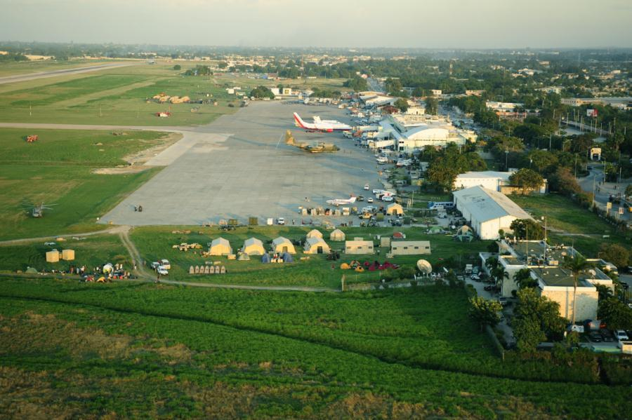

Slide 3
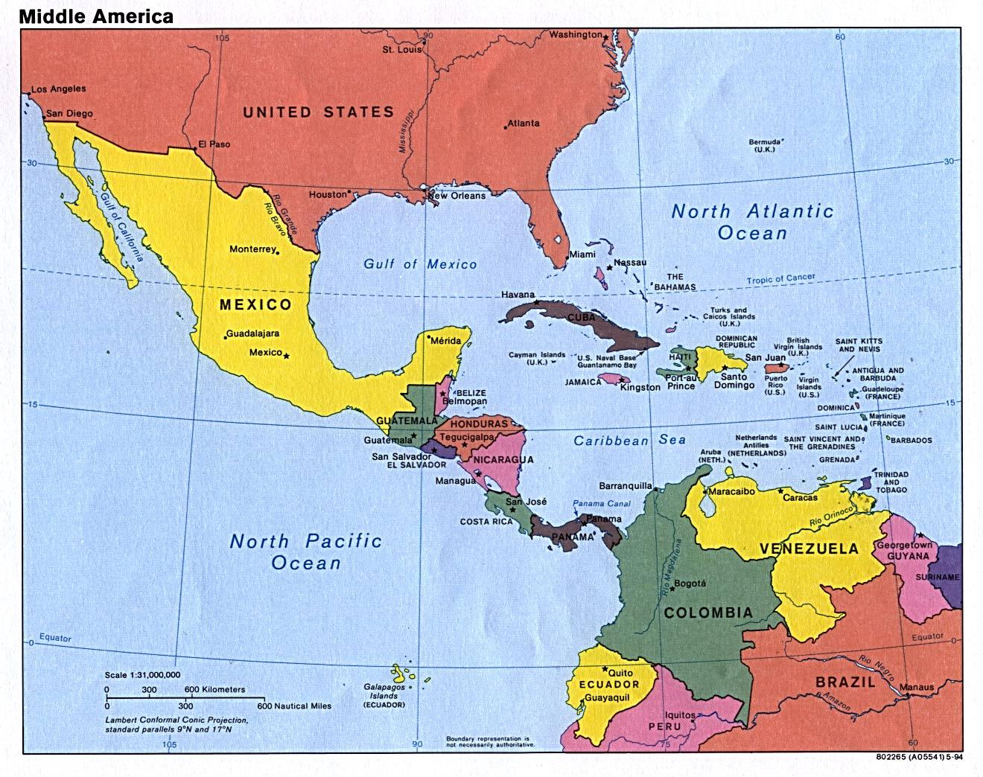

Slide 4
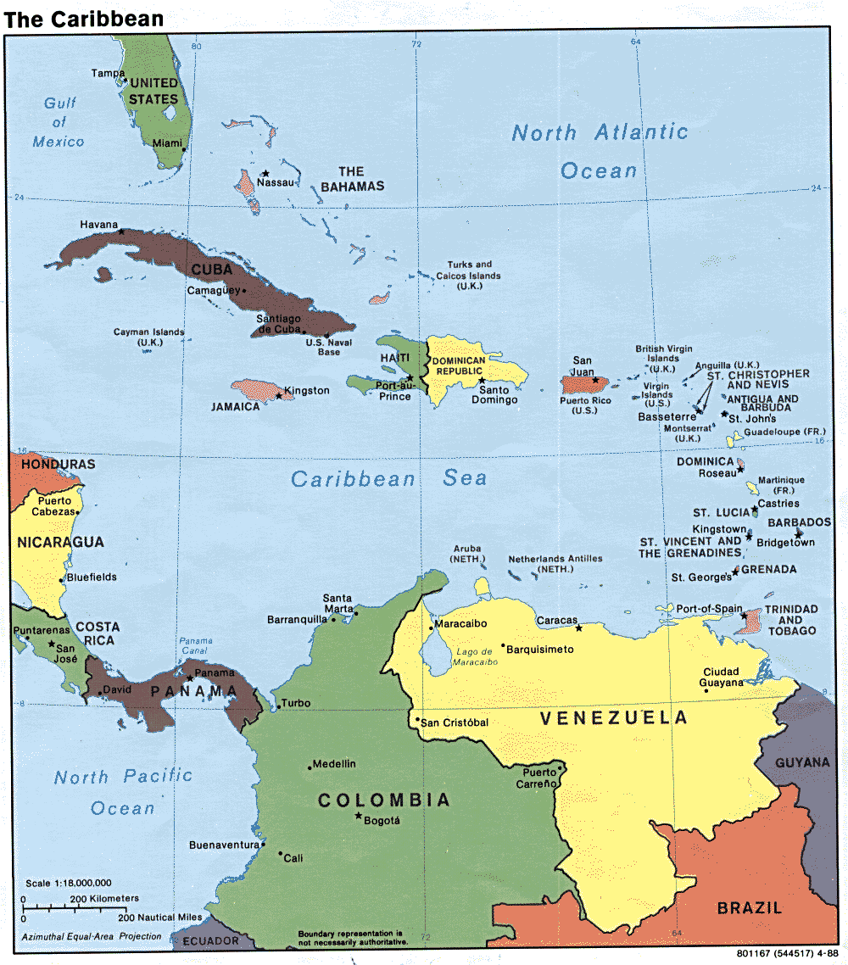

Slide 5
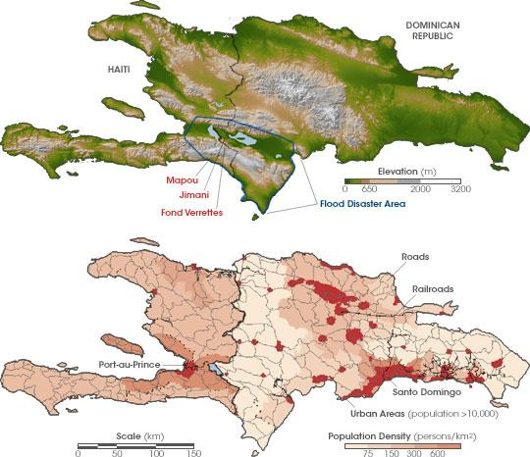

Slide 6
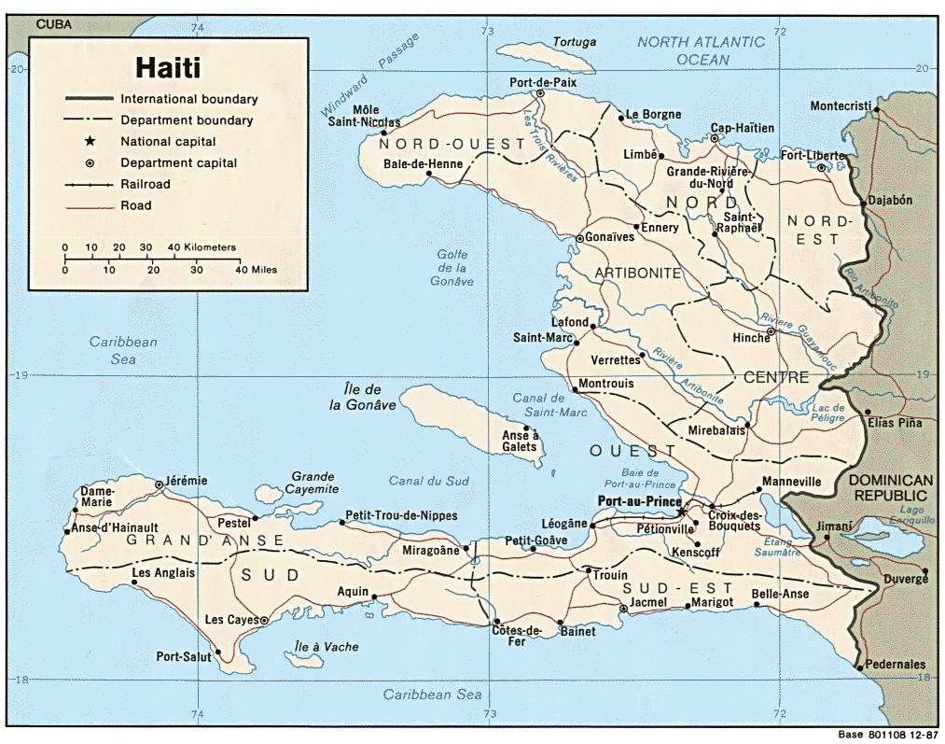

Slide 7
Haiti Vital Data
An Official Census has not been conducted since 2003.
Based on Data from CIA Fact Book:
Population: 9,893,934 (July 2013 est.)
Demographics: 95% African Descent, 4% Mulatto, .75 % Middle Eastern and .25 % European.
Over 46,000 European Aid workers.
Languages: French (official), Haitian Creole (official). 85% Speak Haitian Creole only.
Religions: Roman Catholic 80% (official), Protestant 16%, Other 3%, Islam 1%.
Note: Roughly half of the population practices syncretianized Voudoun.
Mean Life Expectancy: 62.85 years. This reflects the 2009 measurement.

Slide 8
Haiti Vital Data
Adult literacy is variously reported as 52.9% [World Factbook] and 65.3% [United Nations], and the World Bank estimates that in 2004 over 80% of college graduates from Haiti were living abroad, with their remittances home representing 52.7% of Haiti’s GDP. Cite Soleil is considered one of the worst slums in the Americas, most of its 500,000 residents live in extreme poverty. Poverty has forced at least 225,000 Haitian children to work as Restavecs (unpaid household servants); the United Nations considers this to be a modern-day form of slavery.
Minimum Wage in Haiti:
$4.65 to $5.23 (or 200 to 225 gourdes) per day.
Calculated hourly, it will go from 58 to 65 cents, before taxes.

Slide 9


Slide 10
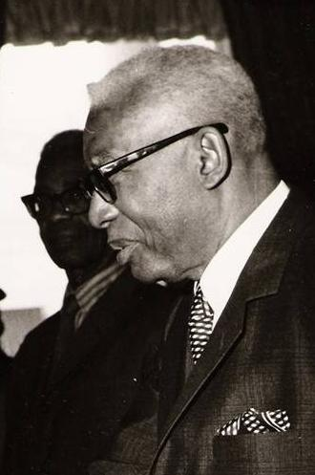
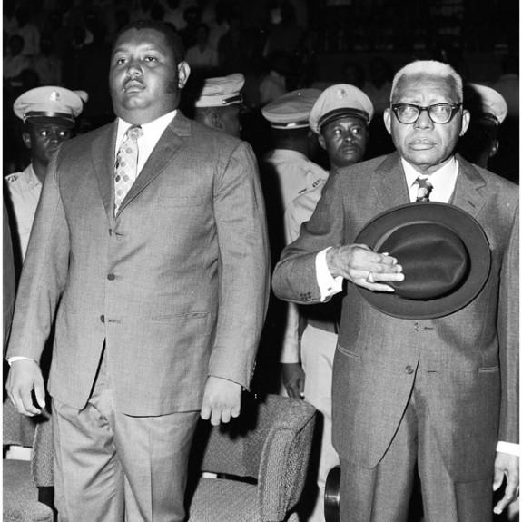
Haiti Political Data: The Duvalier Dictatorship

Slide 11
Haiti Vital Historical Data
Haiti achieved independence in slave revolt that lasted from 1791 to 1804 and pitted Haiti’s slave insurgents against the militaries of England, Spain and France.
In 1844 Haiti agreed to pay an indemnity to France that it would continue to pay until 1947 worth an estimated 21 Billion.
From 1915-1934 the United States of America occupied Haiti.
From 1957 to 1986 the Duvalier father and son dictatorship backed by the United States imposed a reign of brutality and terror in which over 50,000 Haitians were brutally killed and over 80% of professional work force fled the country.
In 1986 the Duvalier dictatorship was toppled by a popular movement based in the Ti Egliz or the liberation theology church network. One of the most prominent leaders of this Lavalas Movement was a Salesian priest named Jean Bertrand Aristide.

Slide 12
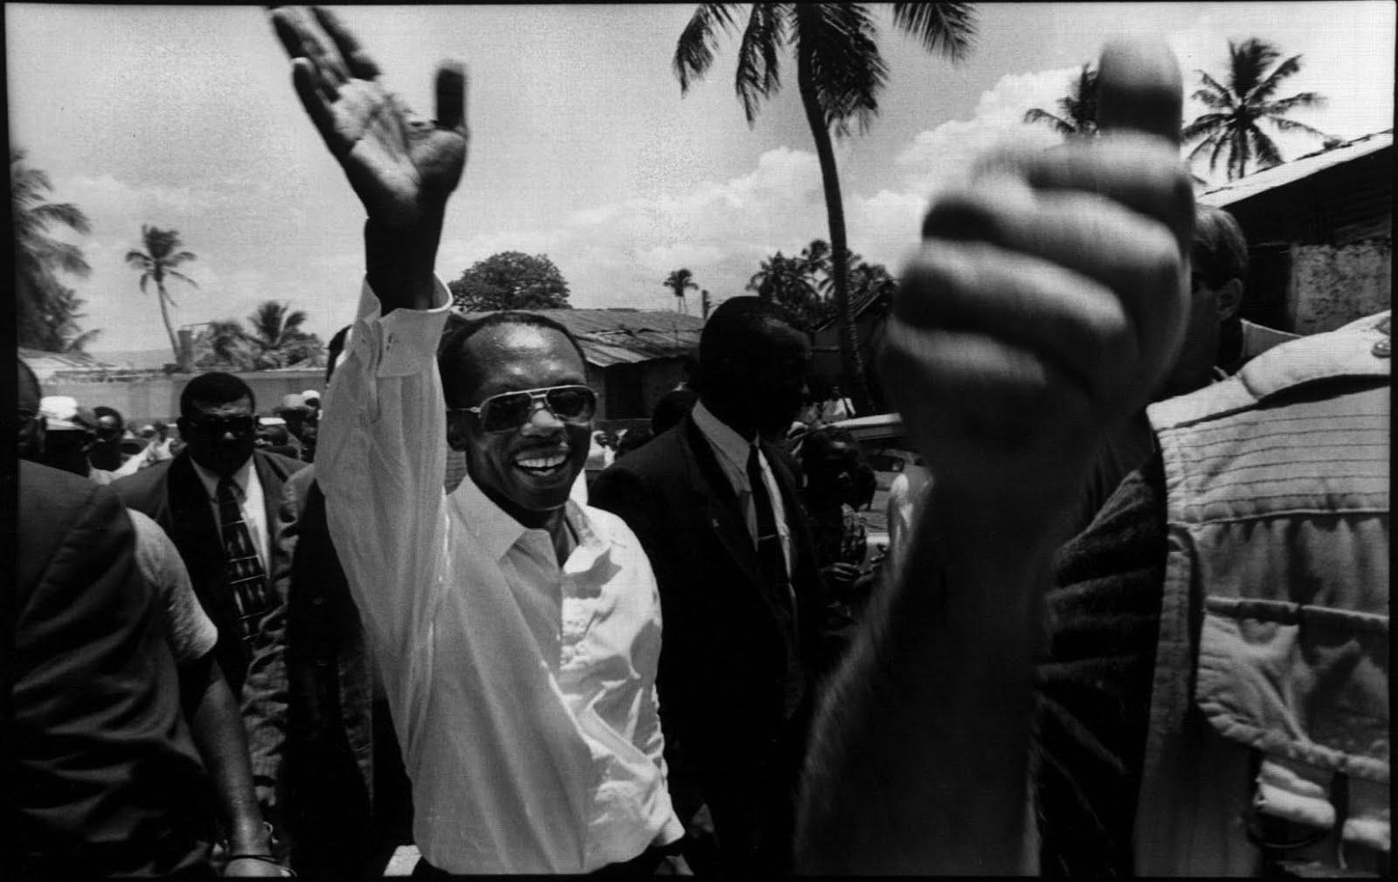
Jean Bertrand Aristide

Slide 13
Haiti Vital Historical Data
Aristide was elected president in 1990 with 67% of the popular vote.
In 1991 Haiti’s first democratically elected president Aristide was toppled in a coup 8 months after being elected.
He was reinstated as President in 1994 following a US military intervention and shortly after he dissolved the army of Haiti in 1995.
He was again toppled by a DIA-CIA financed coup in 2004. He was physically taken by US marines out of Haiti and placed under house arrest in the Central African Republic.
He was not allowed to return to Haiti until 2011. His party Famni Lavalas is currently banned from elections. Backed by Neo-Duvalierists in 2011 Haiti elected Michel Martelly to Presidency. A Pro-US, Pro-Business pop singer named “Sweet Micky”.

Slide 14
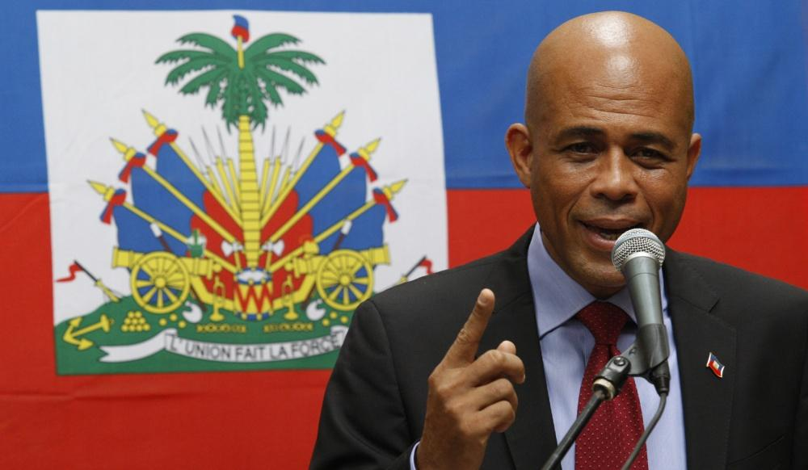

Slide 15
Earthquake of 2010
On January 12, 2010, at 21:53 UTC, (4:53 pm local time) Haiti was struck by a magnitude-7.0 earthquake, the country’s most severe earthquake in over 200 years. The epicenter of the quake was just outside the Haitian capital Port-au-Prince. On 10 February the Haitian government gave a confirmed death toll of 230,000-316,000. Widespread damage resulted from the quake. The capital city was devastated.
The Presidential Palace was badly damaged, with the second floor entirely collapsing onto the first floor; the Haitian Parliament building, UN mission headquarters and the National Cathedral were also destroyed. International aid flowed in but was hampered by damaged infrastructure: the main port was damaged beyond immediate use, the one local airport was of limited capacity and border crossings with the Dominican Republic were distant and crowded. As many as one million Haitians were left homeless.

Slide 16
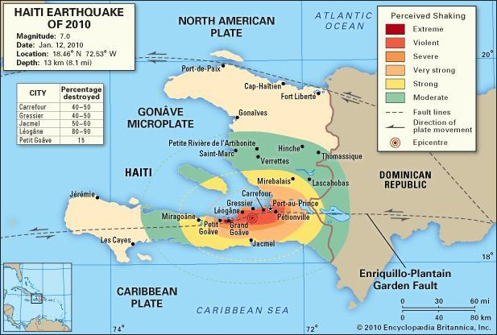

Slide 17
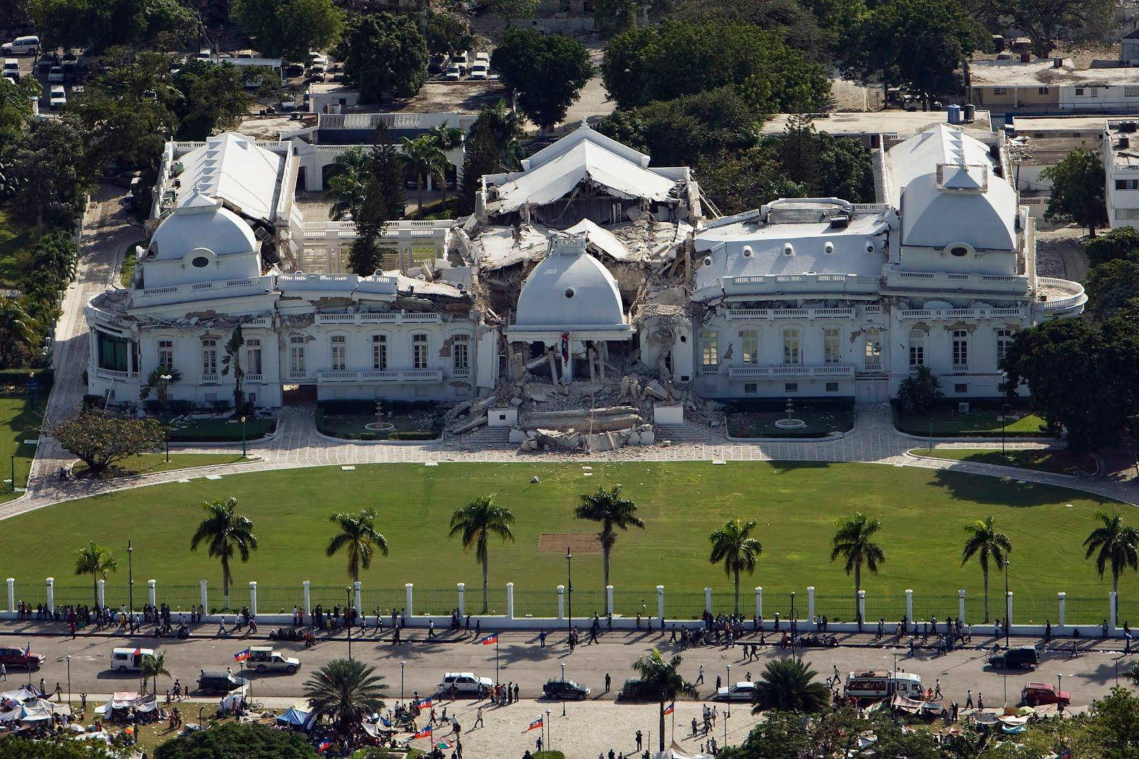
230,000 to 316,000 killed on January 12th, 2010

Slide 18
What is MINUSTAH?
The United Nations Stabilisation Mission In Haiti (UNSTAMIH) (French: Mission des Nations Unies pour la stabilisation en Haïti), also known as MINUSTAH, an acronym of the French translation, is a United Nations peacekeeping mission in Haiti that has been in operation since 2004. The mission's military component is led by the Brazilian Army and the force commander is Brazilian. MINUSTAH's mandate was recently extended by United Nations Security Council Resolution 1944 past its October 15, 2010 deadline amid fears of instability. The mission's current mandate runs through October 15, 2012 with the intention of further renewal. The force is composed of 8,940 military personnel and 3,711 police, supported by an international civilian personnel, a local civilian staff and United Nations Volunteers.

Slide 19
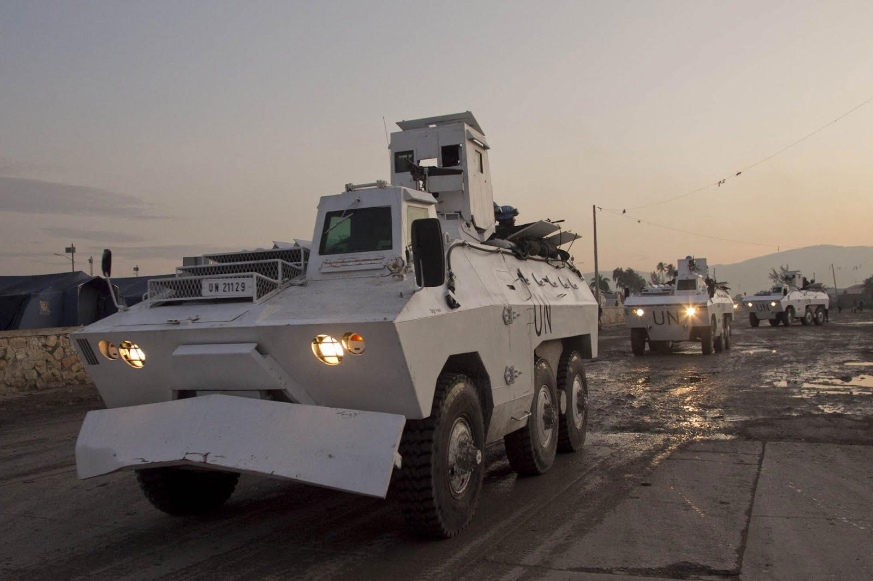
The Haitian Government has twice voted to expel MINUSTAH

Slide 20
Rule of Law/ UN Statistics
285 daily patrols of UN Police/ 700 daily patrols of military contingents
It fails to cite any of its large-scale engagements with “gangs” in which dozens have been injured and killed in repeated engagements with slum militias, gangs and protesters.
Haitian National Police (HNP):
Aristide dissolved the Haitian military after being returned to power by US intervention in 1994. Since that time the HNP has expanded its force under MINUSTAH training. It is estimated that ¼ of the HNP has been infiltrated by the demobilized pro-Duvalier army.
It has grown from 6,676 officers (2004) to 10,132 officers (2012) due to MINUSTA training support.
- Specialized training has been introduced on “Justice of Children” and “Sexual and Gender based violence”.
- The Haitian Customs Surveillance service is now operational in all four land border crossings. This fails to address the hyper-porous nature of that border.
- Ministry of “Human Rights and the Fight Against Extreme Poverty” created. Also the office of Ombudsperson. Such a cumbersome title reflects a dictation from foreign powers not a normative government commitment to either “human rights” or “poverty alleviation”. 78% of the estimated 8 million citizens currently live in “extreme poverty”

Slide 21
Rule of Law
Twice, in September 2011 and May 2013, the Haitian Senate unanimously passed resolutions demanding that MINUSTAH leave Haiti. The latest deadline senators gave all foreign troops to be out of Haiti is May 28, 2014.
Recently following a major gang rape scandal Uruguay will be dropping out of the MINUSTAH alliance.

Slide 22
Governance
Type of State: Presidential Republic
Type of Government: Bicameral parliament with a 30 seat Senate and a 99 seat Chamber of Deputies. The President is elected by universal suffrage, and appoints the Prime Minister with the approval of Parliament. The Prime Minister appoints his government with the approval of the President and the approval of Parliament. Judicial: Court of Cassation
Head of State: President Michel Martelly
Head of Government: Prime Minister Laurent Lamothe
Main Political Parties:
Alternativ, Inite, Ayiti en aksyon, Lavni, MAS, Ansanm nou fò, Repons Peyizan, Konbit, Plateforme libération, Mochrena, OPL, KID, RNDP, Fanmi Lavalas (banned), Tèt Kale, Fusion, AKO

Slide 23
Lavalas ou l’arme
There are only 2 party platforms that matter to the Haitian people and exist outside a small cadre of personalities. “Famni Lavalas” (which is officially banned) and parties funded by foreign or elite pools via the Group of 184 and Democratic Convergence which rely on paramilitary formations build out of the demobilized army such as FRAPH and are backed by the Black, Mulatto and Arab elites.

Slide 24
“The Haitian government doesn’t even know how many NGOs are operating within its borders. No one does. According to Bill Clinton, the UN special envoy to Haiti, the country has the second-highest number of NGOs per capita in the world (India has the highest). He cited the World Bank figure of 10,000 NGOs in Haiti in 2009, at about the same time that Jean-Max Bellerive, then the Haitian minister of planning, estimated that there were 3,000. The Haitian government currently reports 560, though it admits the number operating there is higher.
The earthquake unleashed the NGO hordes on Haiti, but the truth is that NGOs have been a major presence for more than two decades, since before the turmoil in the country that followed the end of the father-son Duvalier dictatorship in 1986. The US government, which had been a key benefactor of the twenty-nine-year Duvalier regime, later encouraged Haiti to lower import tariffs on American rice from 35 percent to just 3 percent. American rice flooded the Haitian market; a similar demise for Haiti’s sugar and coffee industries soon followed.”
One of the final insults experienced by almost any NGO Republic is that its donors decide not only where and how the money will be spent but also when it is no longer needed— which is what is happening in Haiti now. Aid is drying up. Though the international community has delivered just a bit more than half of the $5.3 billion originally pledged to Haiti—52.3 percent as of the end of September—there doesn’t seem to be any plan to make up the difference. Only 52 percent of the $300 million the UN and its partners requested to cover humanitarian aid in 2011 was funded. The figures for this year are worse.
The Republic of NGOs:
Kathie Klarreich and Linda Polman October 31, 2012 | This article appeared in the November 19, 2012 edition of The Nation.
Quote from: Klarreich/Polman Report

Slide 25
The new Cadre de Coordination de l’Aide Externe au Développement d’Haïti (CAED) provides a government-led platform upon which Haiti and its international partners can address priorities within the national plan framework – and it incorporates disaster risk reduction as one of its priorities.
Launch of the CAED in Haiti on 26 November 2012 provides a platform for Haitian stakeholders and the international community to strengthen mutual accountability and trust, and maximize the effectiveness of aid in the country.
MINUSTAH still relies on the CLUSTER MODAL to attempt to coordinate the inumerous NGO efforts.
UN Contributions cited from 2012 Report

Slide 26
Dominican-Haitian Relations
Another major “Human Rights and Extreme Poverty” complication will result from the decision of the government of the Dominican Republic to strip citizenship from people of Haitian descent.
The Dominican Constitutional Court's decision to strip citizenship, from everyone born in the country to immigrants with an illegal status since 1929, has left at least 200,000 Dominicans of Haitian descent stateless.
Ruling no.168-2013, dictated by the constitutional court, has turned the international community on its head. It has been subsquently been forstalled by international preasure.

Slide 27
Return and Rehabilitation
77% decrease in camp population.
Refugees offered payments or evicted by force.
80% of the rubble was cleared by end of 2012.
(10 % by the UN using cash for work/ work for food programs)
200,000 paving stones and 20,000 tiles have been produced out of earthquake rubble and transformed into stairs, corridors, houses.
Close to 7,000 people have been trained on safe construction and rehabilitation practices, urban planning and land tenure system in Haiti.
Housing solutions provided to a total of 158,833 earthquake affected families. (out of
Explore alternative technologies (available and accessible in the Haitian context) and guide the Government towards more sustainable construction practices.

Slide 28
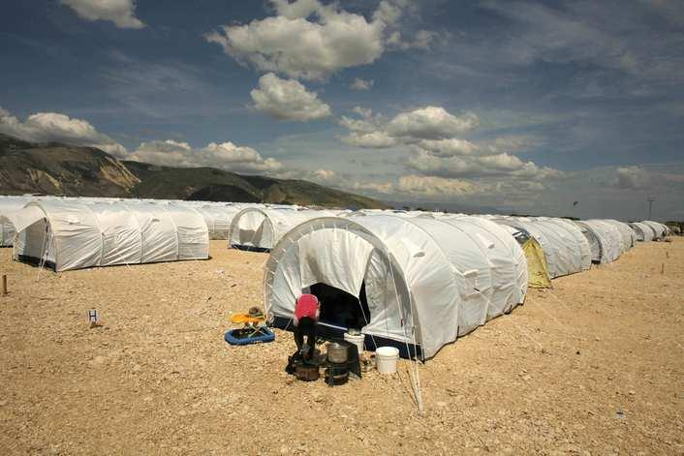

Slide 29
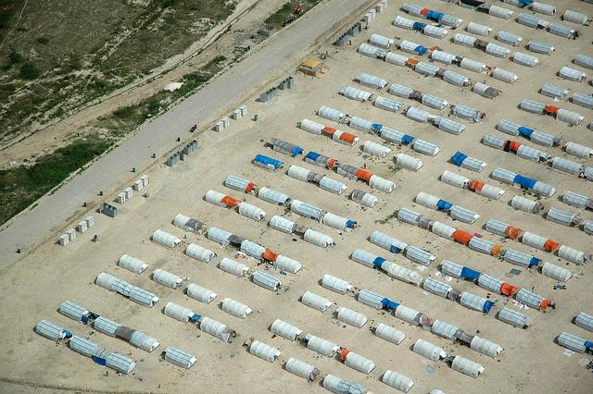

Slide 30
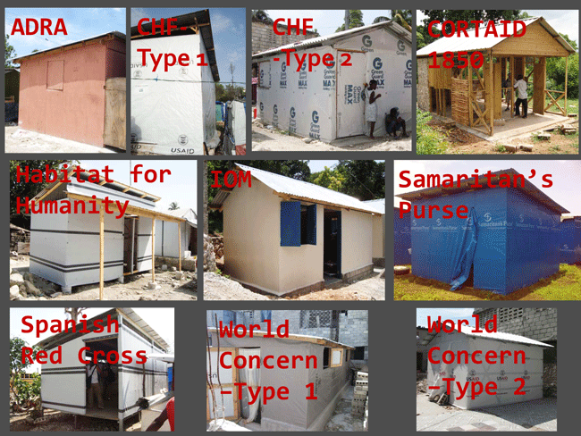

Slide 31
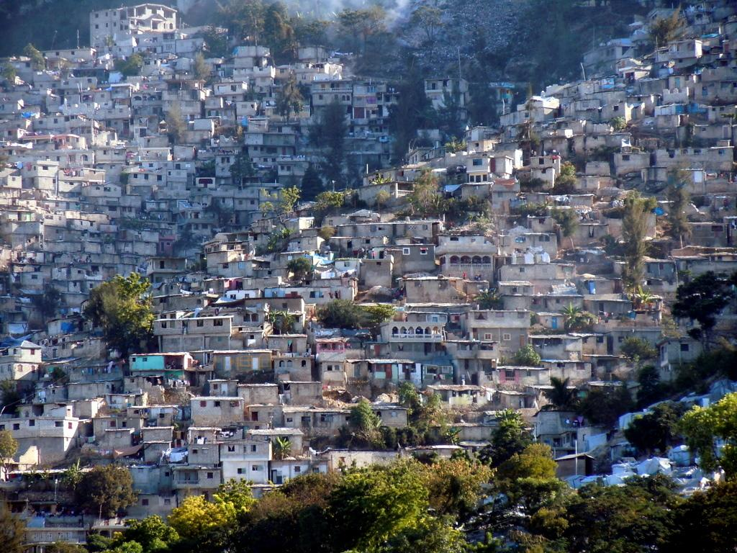
Port-Au-Prince, 2014

Slide 32
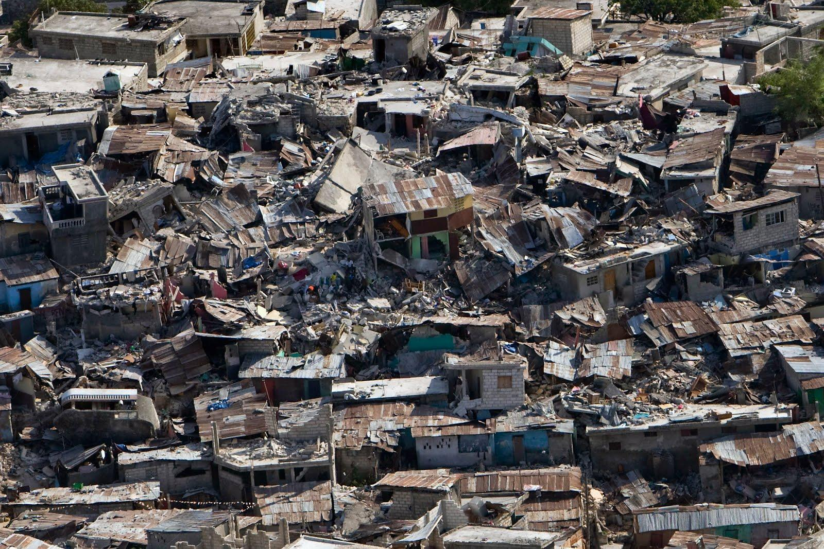
There is still no viable enforcement of building codes.

Slide 33
“Our evaluation also found that international agencies focused on transitional shelters (T-shelters) to the detriment of other more cost-effective and efficient solutions. Despite the early indication that the goals for T-shelter coverage were unrealistic, agencies were too rigid in their plans and were either unable or unwilling to change tack. The NGOs preferred to focus on T-shelters as they were more visible than rental support or repairing homes.
The T-shelters themselves varied according to the agency providing them, though most respected the international norms of material that could withstand earthquakes and hurricanes for a minimum of three years. IOM had pledged to build 9,000 temporary shelters, according to Igor Chantefort, administrator of the temporary shelter program. Six thousand had been built by April 2011 and another 1,100 by September.
According to the IFRC report, the provision of T-shelters was based more on supply than demand. For instance, the estimated number to be built - 125,000 - was based not on a needs assessment but rather on what shelter agencies had pledged to provide. The evaluation noted that decisions were made by agencies “based on their previous know-how, supposed ease of implementation, outcome control, liability concerns and/or visibility,” but not the actual needs of those affected.”
Ruvens Ely Boyer of Haiti Reporters and editor André Lachance collaborated on this piece as part of the International Center for Journalist’ work with Haitian journalists to produce investigative reports.
Quotes on Transitional Shelters (T-Shelters)

Slide 34
Disaster Risk Reduction
About 244 km of streets and roads rehabilitated since October 2011 More than 70 km of irrigation, drainage channels and ditches cleaned. 25,000 m³ of waste and trash removed in 10 major Port-au- Prince ditches by four companies of MINUSTAH’s military engineers, to prevent flooding.
7 multi-purpose centers in some of the most vulnerable communes of the South equipped with solar panels and water purification systems. These centres are used as evacuation locations in the event of a natural disaster.
36 projects to mitigate flooding risks and improve sanitation in vulnerable neighbourhoods (51,000 Haitians employed, including 30% women).
1 national and 10 departmental cyclone season contingency plans available.
4 national and 10 departmental cyclone simulation exercises (SIMEx) and first ever Tsunami SIMEx to improve coordination and response.
More than 4,500 persons in vulnerable areas trained in disaster preparedness, evacuation and first aid.

Slide 35
Health
- The Government, the UN and a coalition of partners led a nationwide vaccination campaign, resulting in nearly 3 million children under 10 years vaccinated against polio, measles and rubella.
- The acute malnutrition rate for children under 5 years old went from 9% in 2006 to 5.1% in 2012. (Please compare the physiological differences of acute and regular malnutrition)
- More than 360,000 Haitians benefited from programs to prevent and treat moderate acute malnutrition, with support from the Ministry of Health and the UN. (They handed out food)
- At the end of 2012, the country-wide cholera case fatality rate was 1.2%, down from a high of 2.4% in November 2010.

Slide 36
Health
- 10-year plan on the elimination of cholera in Haiti finalized by the Ministry of Health and the National Potable Water and Sanitation Directorate (DINEPA), with UN technical assistance.
- HIV infections were reduced by 50% from 2008 to 2012.
- The number of people on antiretroviral drugs over the last 4 years increased by 200%.
- More than 70% of tuberculosis patients were cured in 2012, with support from the Global Fund to fight Aids, Tuberculosis and Malaria. Activities supported by this Fund are implemented by the Government of Haiti, the Haitian Red Cross and several NGO partners.
- More than 62,000 children under five received long lasting insecticide Nets in four of the most endemic departments.

Slide 37
Health
- Four maternity clinics are now operational in the Port- au-Prince area, in the Artibonite and in the South-East departments, providing emergency neonatal obstetrics care, advice on family planning and prevention of mother-to-child transmission services. Such services were also introduced in 11 additional health facilities throughout the country, covering more than 18,300 pregnant women.
- Awareness-raising campaign on sexual and reproductive health reached more than 20,000 youths in the Nippes and South-East Departments.
- In 2012, more than 47,000 Haitians living in camps received preventive health information on water borne diseases, malaria, dengue, Tb/HIV and reproductive health in the Port-au-Prince metropolitan area.
- Innovations such as “Kangeroo Care” showcase the merits of wrapping premature malnourished babies to their mothers chests.

Slide 38
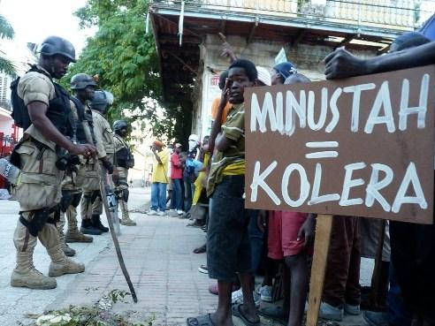
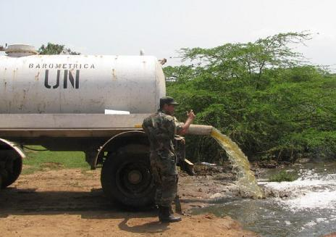
9,000 Haitians are dead and over 900,000 were infected

Slide 39
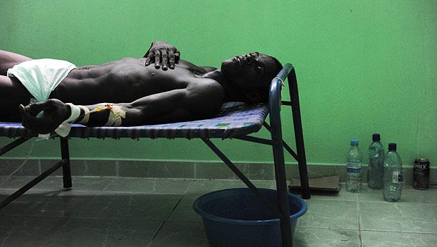

Slide 40
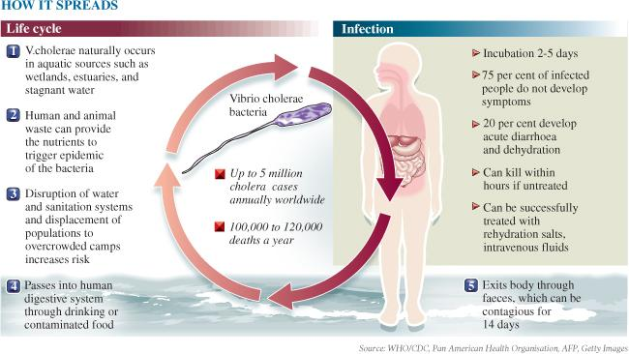

Slide 41
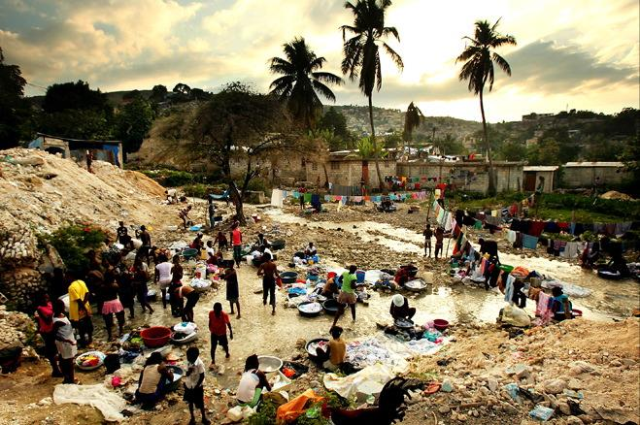
Cholera bacterium samples have been linked to Nepalese MINUSTA contingent.

Slide 42
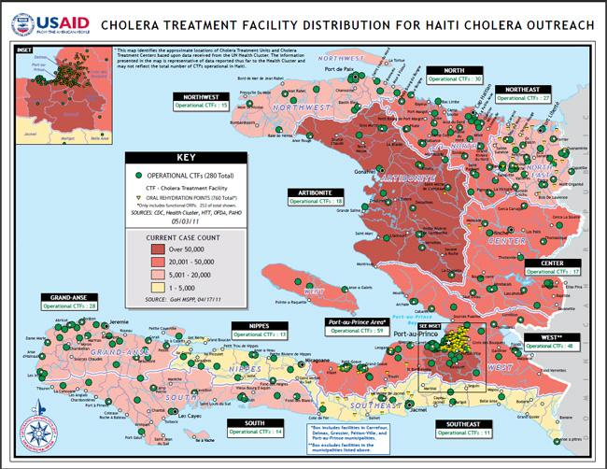

Slide 43
Cholera Prevention & Response
What the UN fact sheet says:
-At the end of 2012, the country-wide cholera case fatality rate was 1.2%, down from a high of 2.4% in November 2010.
-Trainings on Cholera to community health and sanitation agents.
-The UN spent USD 118 million spent to respond to the epidemic since its outbreak.
-Early warning system managed by the ministry of public health is functional.
However, there was a lawsuit in 2013 against the U.N.

Slide 44
Humanitarian Action
What the UN fact sheet says:
- Camp population decreased by 77% over the last two years.
- With storm ISAAC/Hurricane Sandy, the U.N. distributed hygiene kits and provided food and emergency repairs of water network.
- Shortfalls in humanitarian funding reduces response capacities to meet existing humanitarian needs
-Help Haiti to be prepared with Cyclone and Tsunami by simulation exercise.

Slide 45
Employment and Job Creation
What the UN fact sheet says:
-High unemployment rates of approximately 40% with low economic growth.
-Hundreds of Haitians were trained on small business management.
-U.N. purchases local food to support local farmers as well as to stimulate economy.
-Temporary jobs were created after the earthquake in 2010 with rehabilitation of small infrastructure.

Slide 46
The Caracol Industrial Park
In 2012 the Caracol Industrial Park was built on a square mile, 600 acre, 246 hectare, site near Carocol.
The $300 million project, which includes a 10-megawatt power plant, road, a water-treatment plant, worker housing in neighboring communities, and development of a port in nearby Fort-Liberté, was built with hurricane relief funds, a loan from the Inter-American Development Bank, contributions by the United States government, and The Clinton Foundation. Bill Clinton and Hillary Clinton, United States Secretary of State, played central roles in supporting and promoting the project. The anchor tenant is SNH Global, S.A, a subsidiary of Sae-A Trading Co. Ltd, Sae-A, a global clothing manufacturer headquartered in South Korea. It will begin operations in the fall of 2012; a workforce of 20,000 is projected. The eventual workforce is projected to approach 65,000 and result in a tenfold expansion of population in the area to about 300,000 from its present 30,000. Social and environmental disruption is anticipated as the result of this hastily-planned project.
Deborah Sontag (July 5, 2012). "Earthquake Relief Where Haiti Wasn’t Broken". The New York Times. Retrieved July 6, 2012.

Slide 47
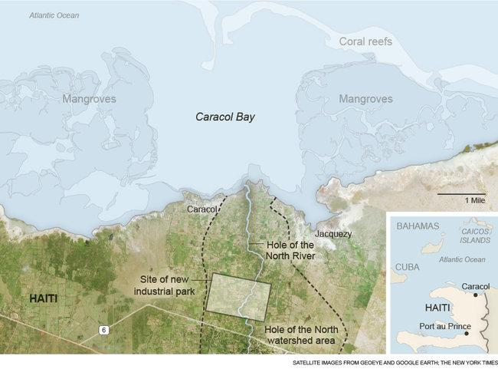

Slide 48
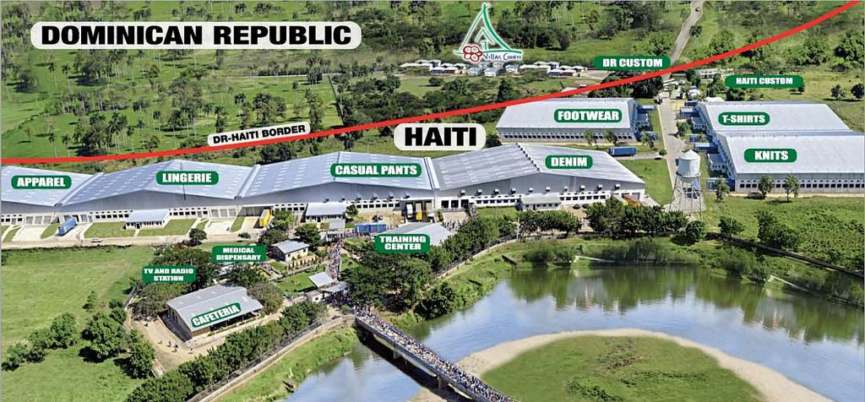
Caracol Industrial Park

Slide 49
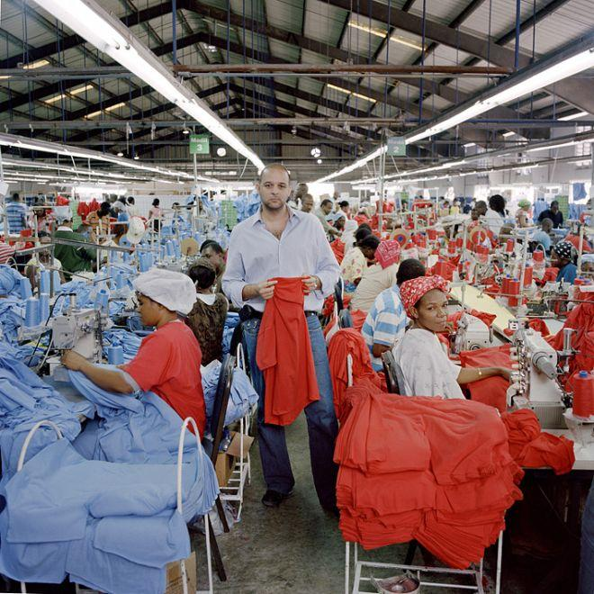

Slide 50
It started when Haiti passed a law two years ago raising its minimum wage to 61 cents an hour. According to an embassy cable:
This infuriated American corporations like Hanes and Levi Strauss that pay Haitians slave wages to sew their clothes. They said they would only fork over a seven-cent-an-hour increase, and they got the State Department involved. The U.S. ambassador put pressure on Haiti’s president, who duly carved out a $3 a day minimum wage for textile companies (the U.S. minimum wage, which itself is very low, works out to $58 a day).
Haiti has about 25,000 garment workers. If you paid each of them $2 a day more, it would cost their employers $50,000 per working day, or about $12.5 million a year ... As of last year Hanes had 3,200 Haitians making t-shirts for it. Paying each of them two bucks a day more would cost it about $1.6 million a year. Hanesbrands Incorporated made $211 million on $4.3 billion in sales last year.
Thanks to U.S. intervention, the minimum was raised only to 31 cents.
These papers have come to light thanks to Haiti Liberte, a small Haitian newspaper with offices in Port-au-Prince and New York City.
Wikileaks reveals US pressure to reduce minimum wage

Slide 51
Environment
What the UN fact sheet says:
-Country’s forest cover dramatically decreased and watershed are degraded.
-The U.N. works in watershed management, promotion of renewable energy.
-Helped with the construction of two hydropower stations.
-Planted more than 300 hectares with forest and fruit tree.

Slide 52
Environment
UN Fact Sheet:
Over the past thirty years, the country’s forest cover dramatically decreased and now represents less than two per cent of the Haitian territory. Eighty-five per cent of the country’s watersheds are degraded. Such degradation causes frequent floods, soil erosion, and important losses of nutrients essential for agriculture.

Slide 53
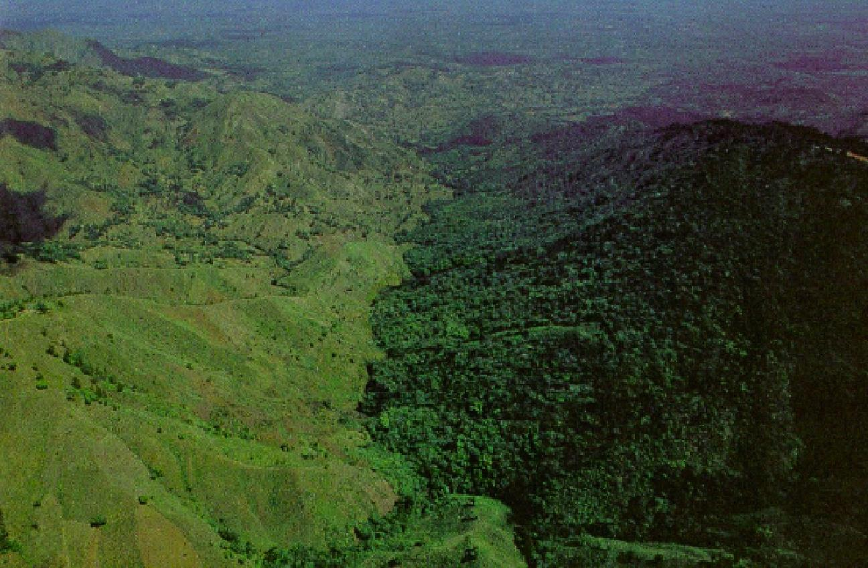

Slide 54
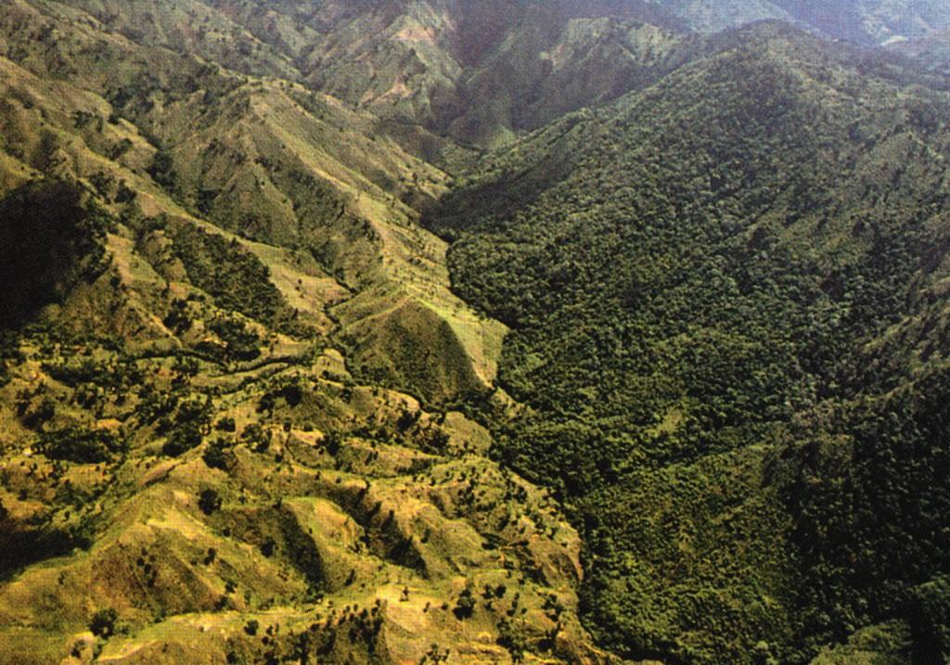

Slide 55
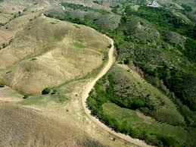

Slide 56
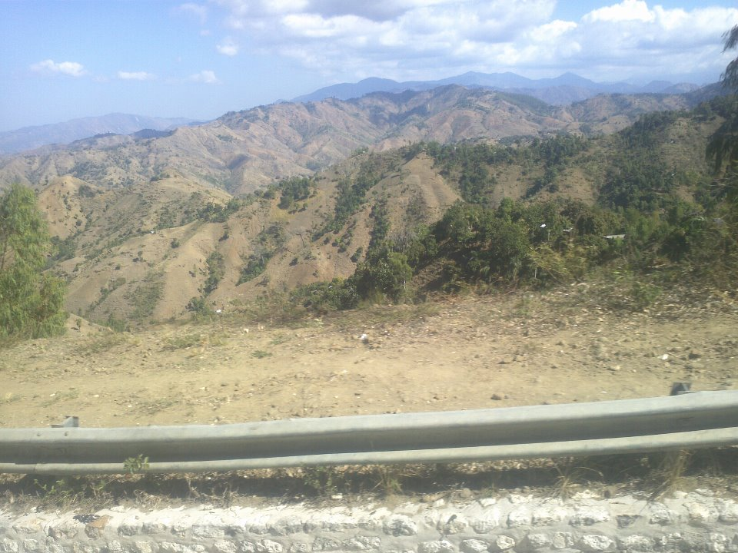

Slide 57
Education
The U.N. works with the government of Haiti to increase children’s access to school, abolish education fees, and define quality standards for state and non-state service providers.
77% of children of primary school age (11-16) are attending primary school. The government of Haiti reports that it will likely meet its MDG in reagrds to education.
According to US State Department Haiti has a child slave (Restovek) population around 225,000.

Slide 58
